Slide 1


Emergency Broadband Benefit
What Is the Benefit?
Who Is Eligible?
How Can Households Apply?
FCC Partner Toolkit

Slide 2


The Emergency Broadband Benefit Program is a Federal Communications Commission (FCC) Program that provides a temporary discount on monthly broadband bills for qualifying low-income households. Eligible households can receive:
Up to $50/month discount for broadband service and associated equipment rentals;
Up to $75/month discount for households on Tribal lands, and;
A one-time discount of up to $100 for a laptop, desktop computer, or tablet purchased through a participating provider.

Slide 3

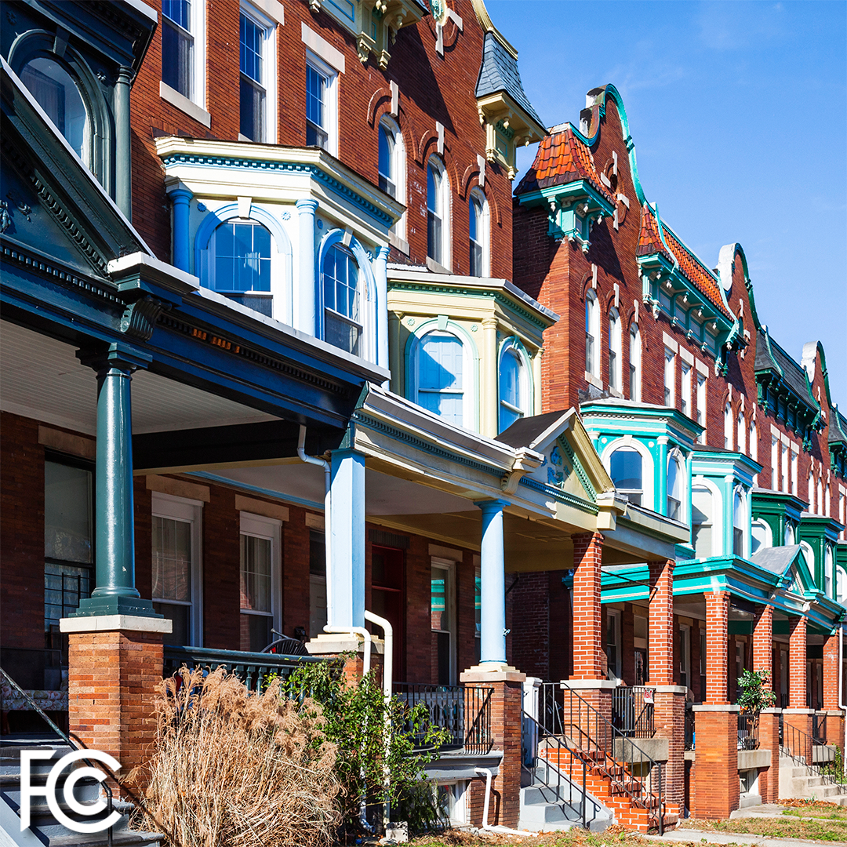
A Household Is Eligible If Any Member
Received a Pell Grant in the current award year;
Is approved to receive benefits under the free and reduced school lunch program or school breakfast program in the 2019-2020 or 2020-2021 school year;
Experienced a substantial loss of income, due to a job loss or furlough since 2/29/20 and the household had a total income in 2020 below $99,000 (single filers) or $198,000 (joint filers); or
Meets the eligibility of a participating providers’ existing low-income or COVID-19 program.

Slide 4

Households That Qualify for Lifeline, Also Qualify
What Is Lifeline?
Lifeline is a federal program that lowers the monthly cost of phone and internet. Eligible customers will get up to $9.25 (up to $34.25 on Tribal lands) toward their bill.
How Do I Qualify for Lifeline?
Household income is less than 135% of the Federal poverty guidelines
or
A member of the household participates in one of these programs:
Supplemental Nutrition Assistance Program (SNAP), formerly known as Food Stamps
Medicaid
Supplemental Security Income (SSI)
Federal Public Housing Assistance (FPHA)
Veterans Pension and Survivors Benefit
Tribal programs (and you live on qualifying Tribal lands)

Slide 5

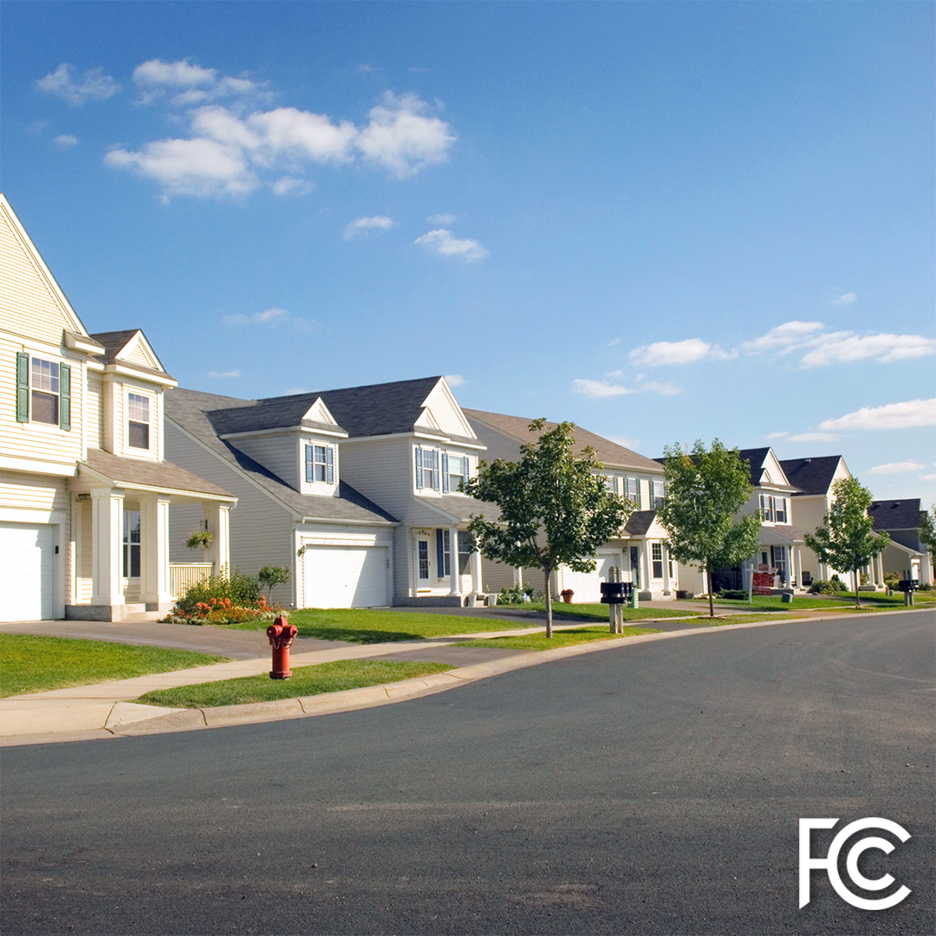
A household is a group of people who live together and share money (even if they are not related to each other.) If you live together and share money, you are one household. If you either don’t live together or you don’t share money, you are two or more households.
A household can qualify because of eligible dependent children that meet the eligibility criteria.
You may have to answer questions about your household when you apply for the Emergency Broadband Benefit Program.
A household worksheet will be available to assist in determining household eligibility.

Slide 6


Eligible households within multi-unit dwellings such as apartment buildings, nursing homes, and group homes can also take advantage of the benefit.
Households within multi-unit dwellings, where the landlord or the property manager is the internet account holder, may be able to apply the benefit to that broadband service if they otherwise qualify.
If the household has a bill or other liability for their broadband access that someone else, such as the property owner, is helping to pay, the household could switch temporarily to using EBB support to pay for broadband service instead of relying on that third party’s support.

Slide 7


The Emergency Broadband Benefit will open its enrollment on May 12, 2021.
The Emergency Broadband Benefit is a temporary program developed in response to the COVID-19 pandemic. The program will end once the program funds are exhausted, or six months after the Department of Health and Human Services declares and end to the pandemic, whichever comes first.
The program is administered by the Universal Service Administrative Company (USAC). They also administer the Lifeline program. USAC hosts the application portal and the GetEmergencyBroadband.org consumer website.

Slide 8

Participating providers must give households notice about the last date or billing cycle that the full benefit will apply to their bill and the date or billing cycle that a partial benefit will apply to their bill, in addition to information about the cost of broadband service after the program ends.
Households will need to opt-in or request to continue broadband services with their provider. If they don’t opt-in or select a new service plan with the provider, their broadband service will end once the program ends. Even if they had service with the same provider before enrolling in the Emergency Broadband Benefit, they will need to opt-in to continue broadband services after the program ends.

Slide 9

The program is open to all broadband providers, not just those currently offering Lifeline services.
Fixed broadband services are provided to your home, or a single location. These include cable, fiber optic, DSL, satellite, and fixed wireless services.
Mobile broadband services are device-based and available throughout the service provider’s cellular coverage area, similar to cell phone services.
Check with the broadband providers in your area to learn about their plans for program participation and eligible service offerings. You can find a list of participating providers by state and territory linked on www.fcc.gov/broadbandbenefit.
Not all providers plan to offer connected devices through the program.

Slide 10


There are three ways to apply for the Emergency Broadband Benefit
Option 1: Contact a participating broadband provider directly to learn about their application process.
Option 2: Go to GetEmergencyBroadband.org
to apply online and to find participating providers near you.
Option 3: Send a mail-in application, along with proof of eligibility to: Emergency Broadband Support Center
P.O. Box 7081
London, KY 40742

Slide 11


Contact a service provider. Find a list of participating service providers by state at: www.fcc.gov/broadbandbenefit.
The service provider assists the consumer (in-person) with applying through the National Verifier Service provider portal; or
The service provider helps the consumer apply using their FCC approved alternate verification process.

Slide 13
EBB Program:
Application Process

Slide 14
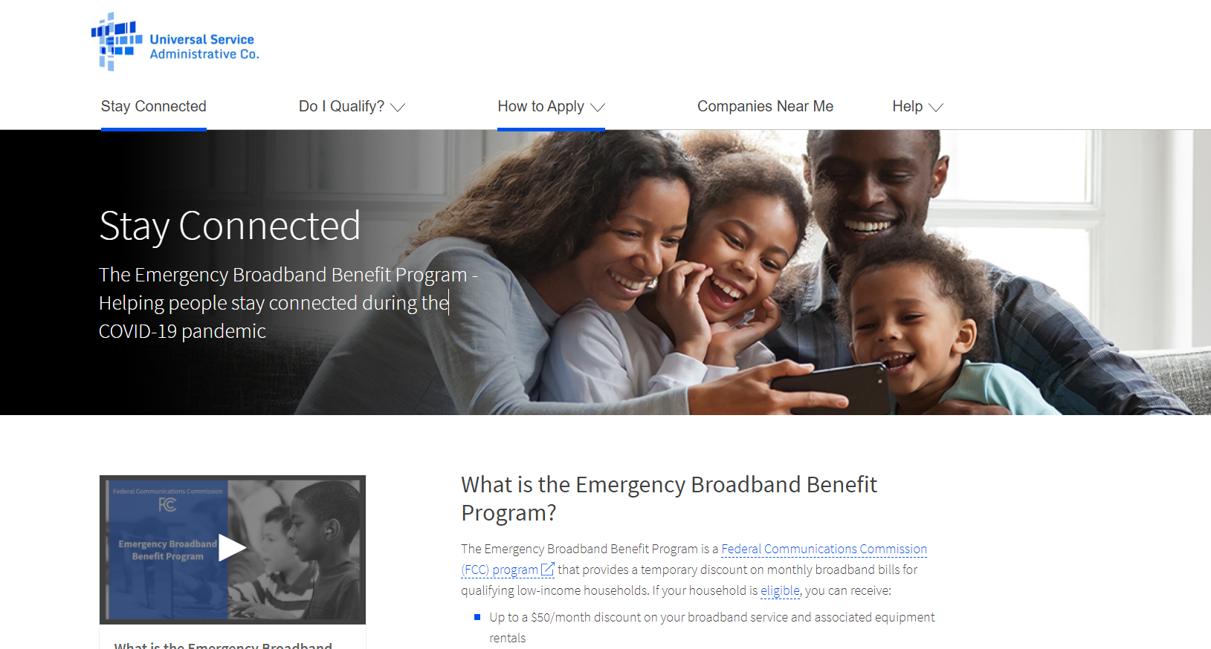
Apply Online: GetEmergencyBroadband.org
Notes:
Consumers begin the supplication process by visiting GetEmergencyBroadband.org and selecting the Apply Now button.
Application is not yet live, so that button isn’t visible on the site
Consumer can also use the site to find information on the program, get resources and find service providers who offer EBB Program service in their area.

Slide 15
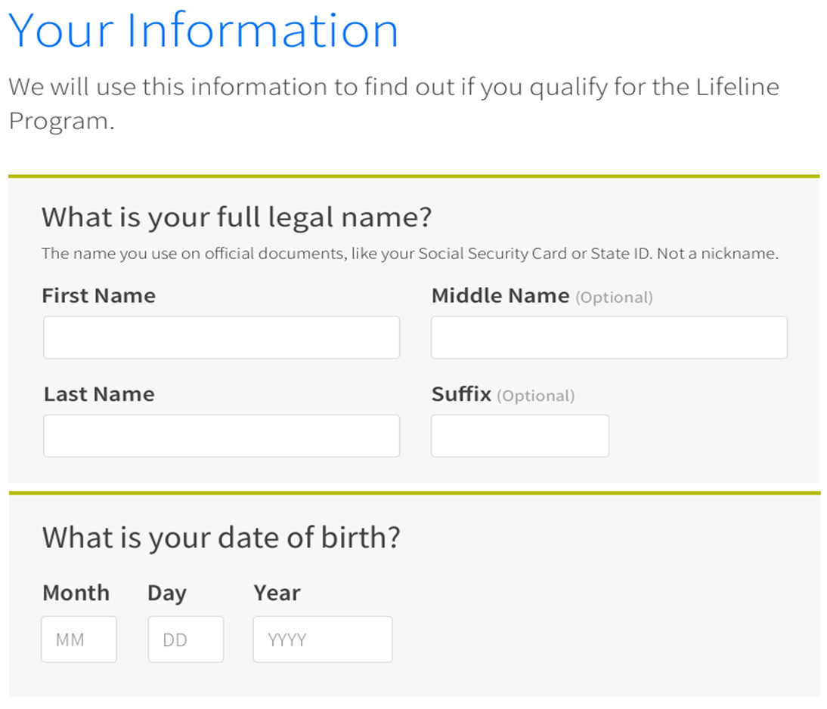
Apply Online
Emergency
Broadband Benefit Program or the Lifeline Program
First and last name may only consist of letters, hyphens, spaces, and single quotes
The first name should be the consumer’s legal name, not a nickname
The last name must be at least 2 characters
Date of birth must be in the MM/DD/YYYY format
Notes:
Consumers are taken directly to the EBB Program application. At this stage, the application flow is the same for both Lifeline and the EBB Program, so you’ll see language aimed at both consumers.
Consumers enter their full legal name – not a nickname – and their date of birth.

Slide 16
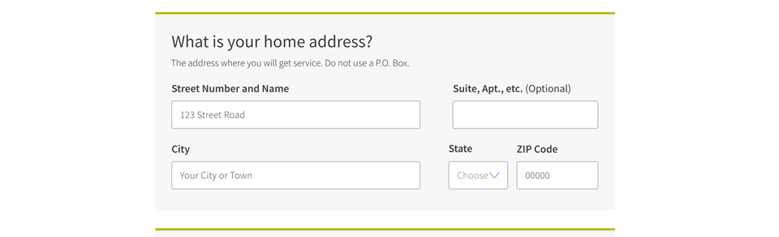
Apply Online
Notes:
On that same screen, the consumer will enter their residential address – the address where they plan to receive service. This cannot be a PO box. Consumers who don’t have a street number and street name can enter a descriptive address. We will capture a consumers mailing address – if it’s different – later in the process.

Slide 17
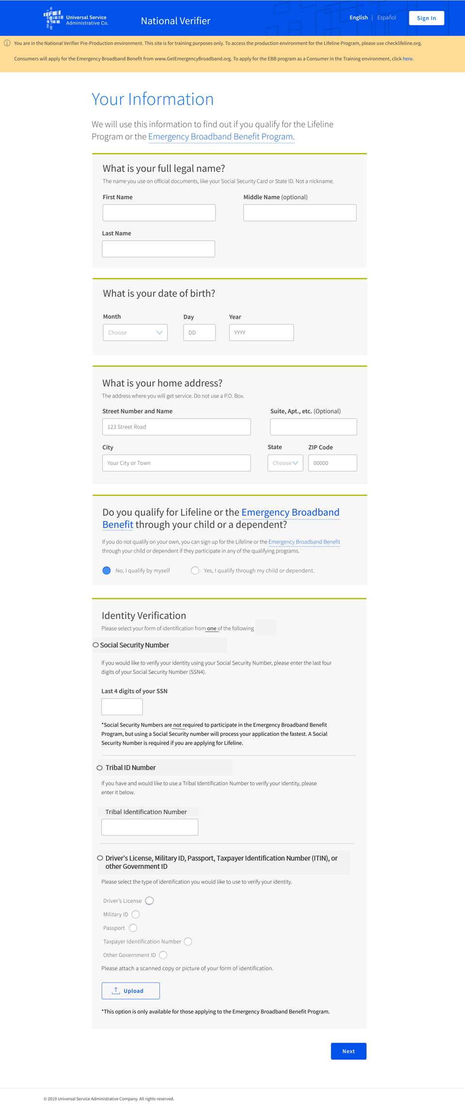
Apply Online
Notes:
Next the consumer will let us know if they plan to qualify themselves or through a child or dependent – in the program we refer to this as a Benefit Qualifying Person – by selecting the correct button. The EBB Program is a household benefit, so consumers can apply if someone in their household is eligible – even if it is a dependent or child.
At this stage, the consumer lets us know how they’d like to verify their identify – but providing the last 4 digits of their social security number, by supplying a Tribal ID number or by uploading documents such as a driver’s license, passport, Tax payer ID number or other government ID. This screen lets consumers know that entering an SSN4 is not required for this program, but that providing an SSN4 allows their application to be processed the most quickly.
TBD: If the consumer chooses to verify their identity using documents, they can upload copies of those document using the upload button on this screen.

Slide 18
Apply Online
Notes:
In the next section, consumers tell us how they want to demonstrate their identity – by entering the last four digits of their social security number, sharing their Tribal ID or showing government-issued identity documents. The consumer will click the circle next o their chosen option and enter the required information. If the consumer chooses to share an ID, they can upload a scan or photo on this screen. One note – consumers who choose to upload documents will require a manual review, so the application notes that entering a social security number will allow for the fastest processing times.

Slide 19
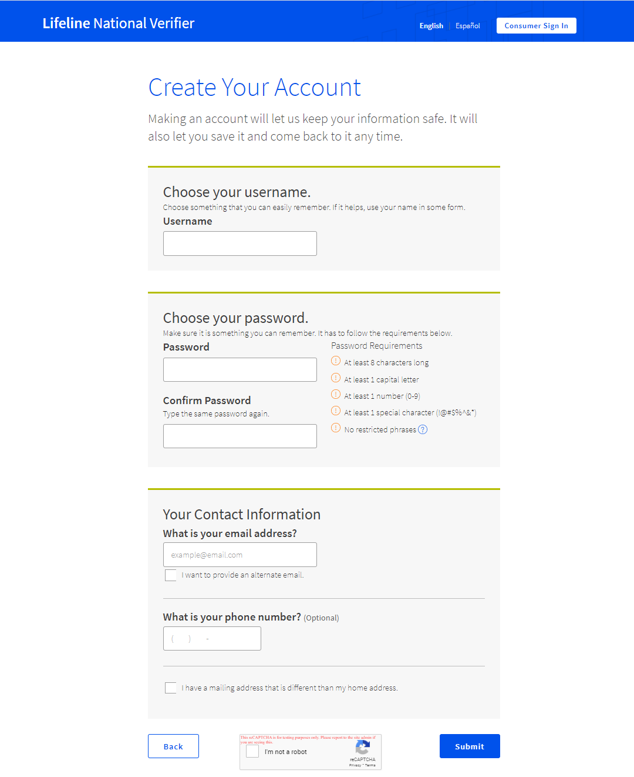
Apply Online
Notes:
Now the consumer creates an account so they can come back to their application if they need to enter documents or want to check their eligibility result. On this screen they can enter their email address – and add a second email if there’s another person or we should inform about the status of their application – and add a phone number. If the consumer has a mailing address that’s different from their service address (including PO boxes), they can click the box and enter that information.

Slide 20
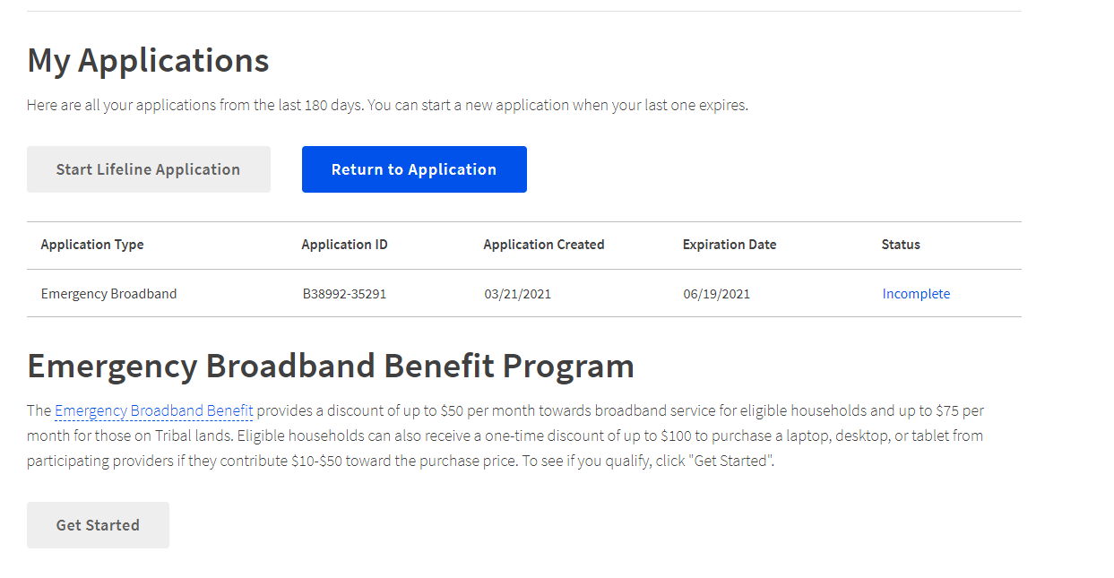
Apply Online
Notes:
Once an account is created, the consumer sees their account homepage. At this point is will let the consumer know that they need to complete their EBB Program application. The consumer can select “get started” to complete the process.

Slide 21
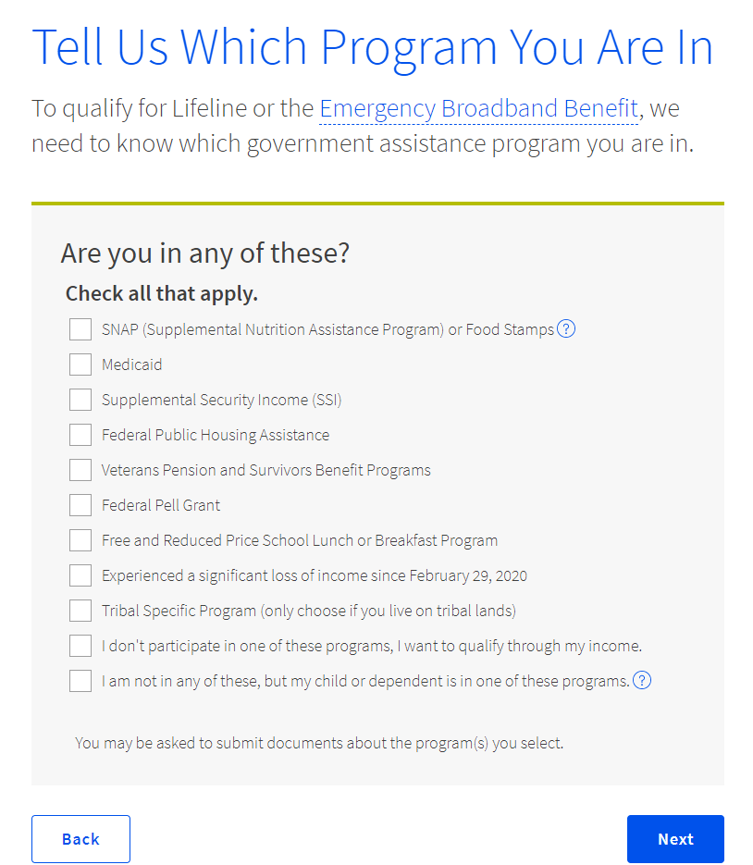
Apply Online
Notes:
The consumer will be asked to let us know which qualifying program(s) they participate in. If they want to qualify through a Tribal specific program, clicking that box will bring up a list of eligible Tribal specific programs – and reminds them that they must live on qualifying Tribal lands to use that process. It also gives consumers the option to choose that they want to qualify through income, through loss of income or that they want to qualify on behalf of a child or dependent.

Slide 22
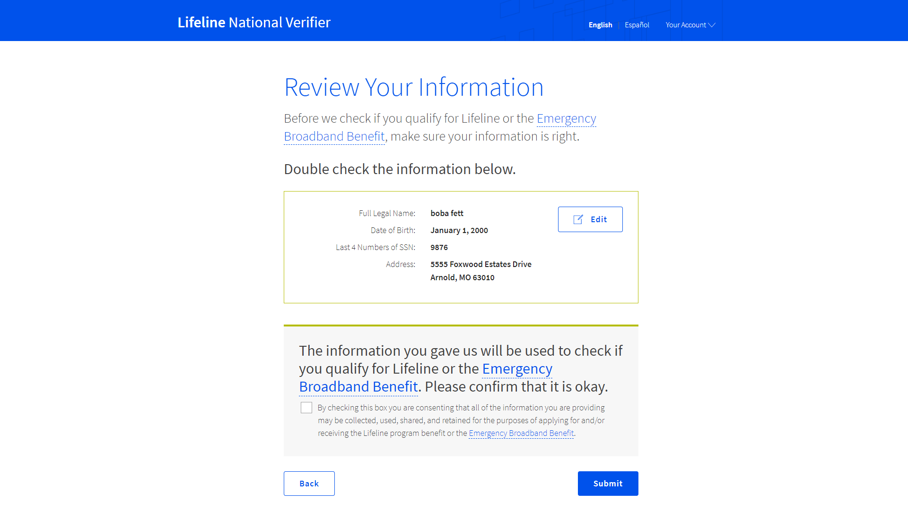
Apply Online
Notes:
After the consumer selects the qualifying program or programs, they'll be shown the information they shared so they can confirm it is all correct and that they didn’t mistype. Once they double check the information. The consumer checks the box giving the EBB Program consent to use the submitted information to check their program eligibility. When they click submit, the National Verifier will check their identity, address and eligibility against our electronic databases.

Slide 23
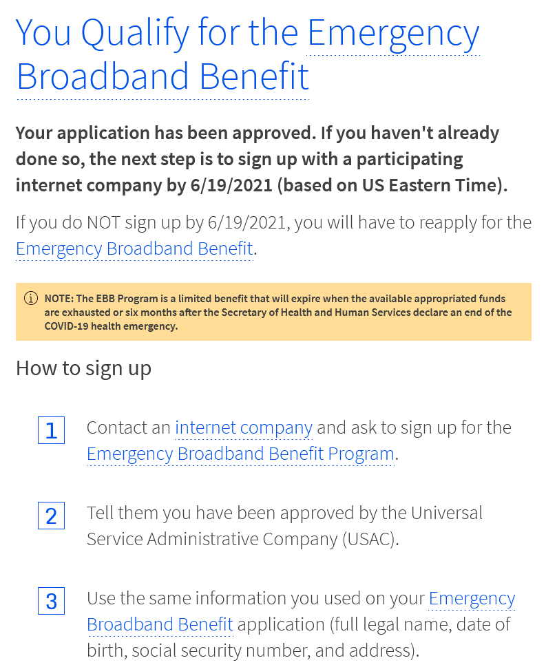
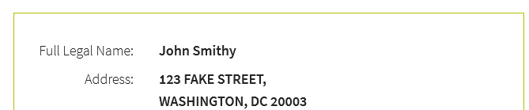
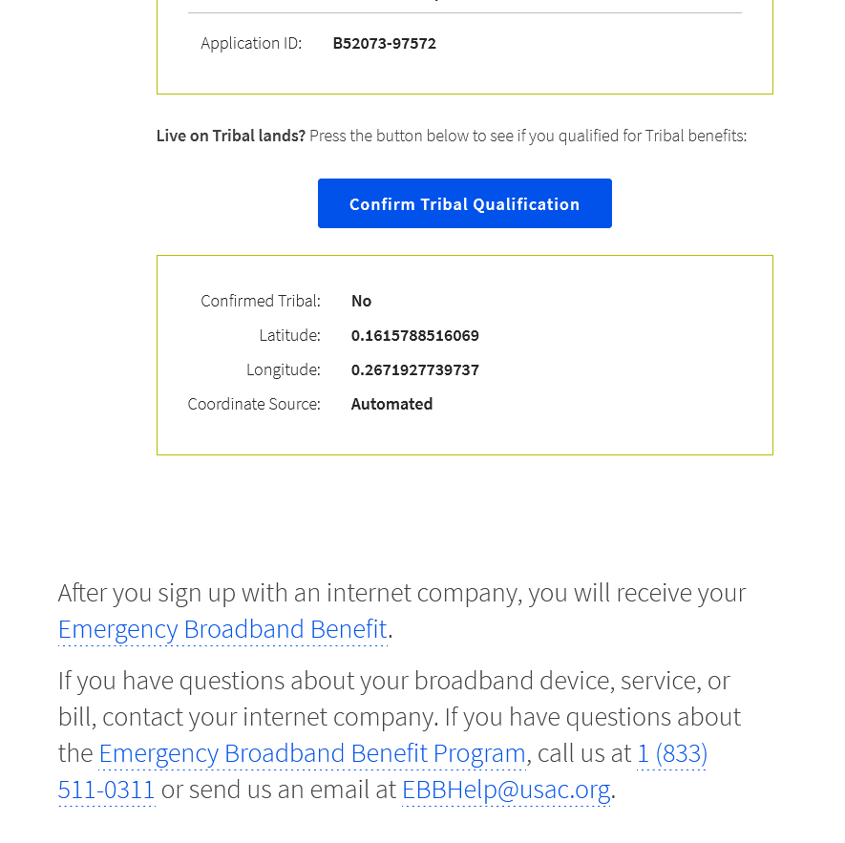
Notes:
If the consumer’s identity, address and eligibility could be confirmed using our available data sources, the consumer receives a success screen that details their next step – contact an internet company and enroll in the program. This links the consumer to the companies near me tool to find local companies. It also provides contact information and lets them know how long their eligibility decision is good for. Since EBB is a limited program, it encourages them to sign up soon.
If the consumer lives on Tribal lands an wants to qualify for the enhanced benefit, they can do that from this screen – which allows them to use a map to share their latitude and longitude.

Slide 24
Apply Online
Correct Errors through the National Verifier
Use the portal to correct address and duplicate errors
Upload Identity Documents
Upload Eligibility Documents
Notes:
For consumers who could not be verified using our databases, they’ll have the opportunity to correct errors through the system. Some – like address questions or duplicate households – can be corrected right in the portal, while others require document upload.

Slide 25
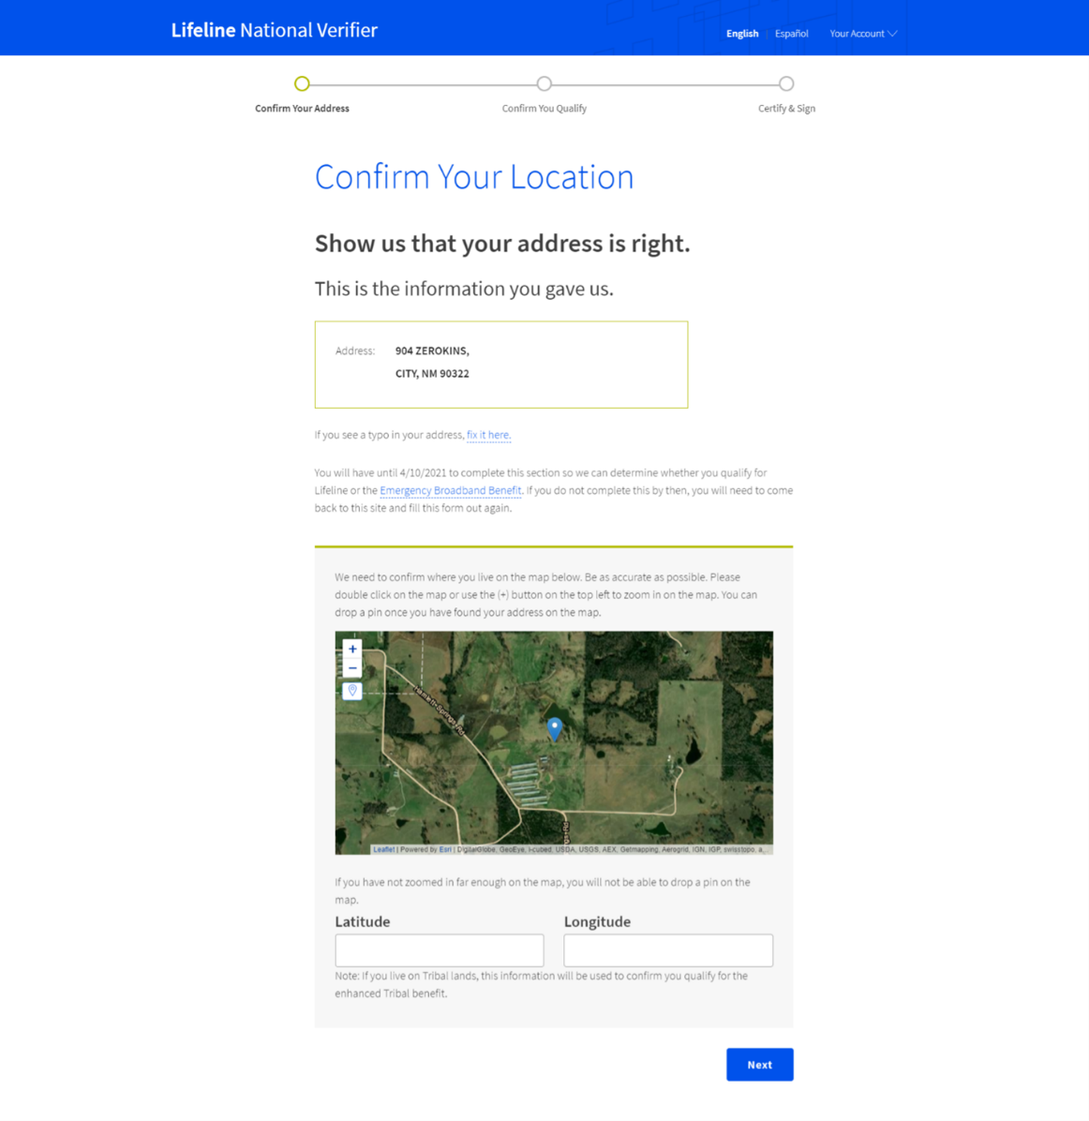
Apply Online
Notes:
If we can’t identify a consumer’s address using the AMS tool, the consumer can show us where they live using the map. It starts with a zoomed out map of the location they gave, and allows the consumer to zoom in and drop a pin to show us their exact location. It then drops a pin to record the latitude and longitude.

Slide 26
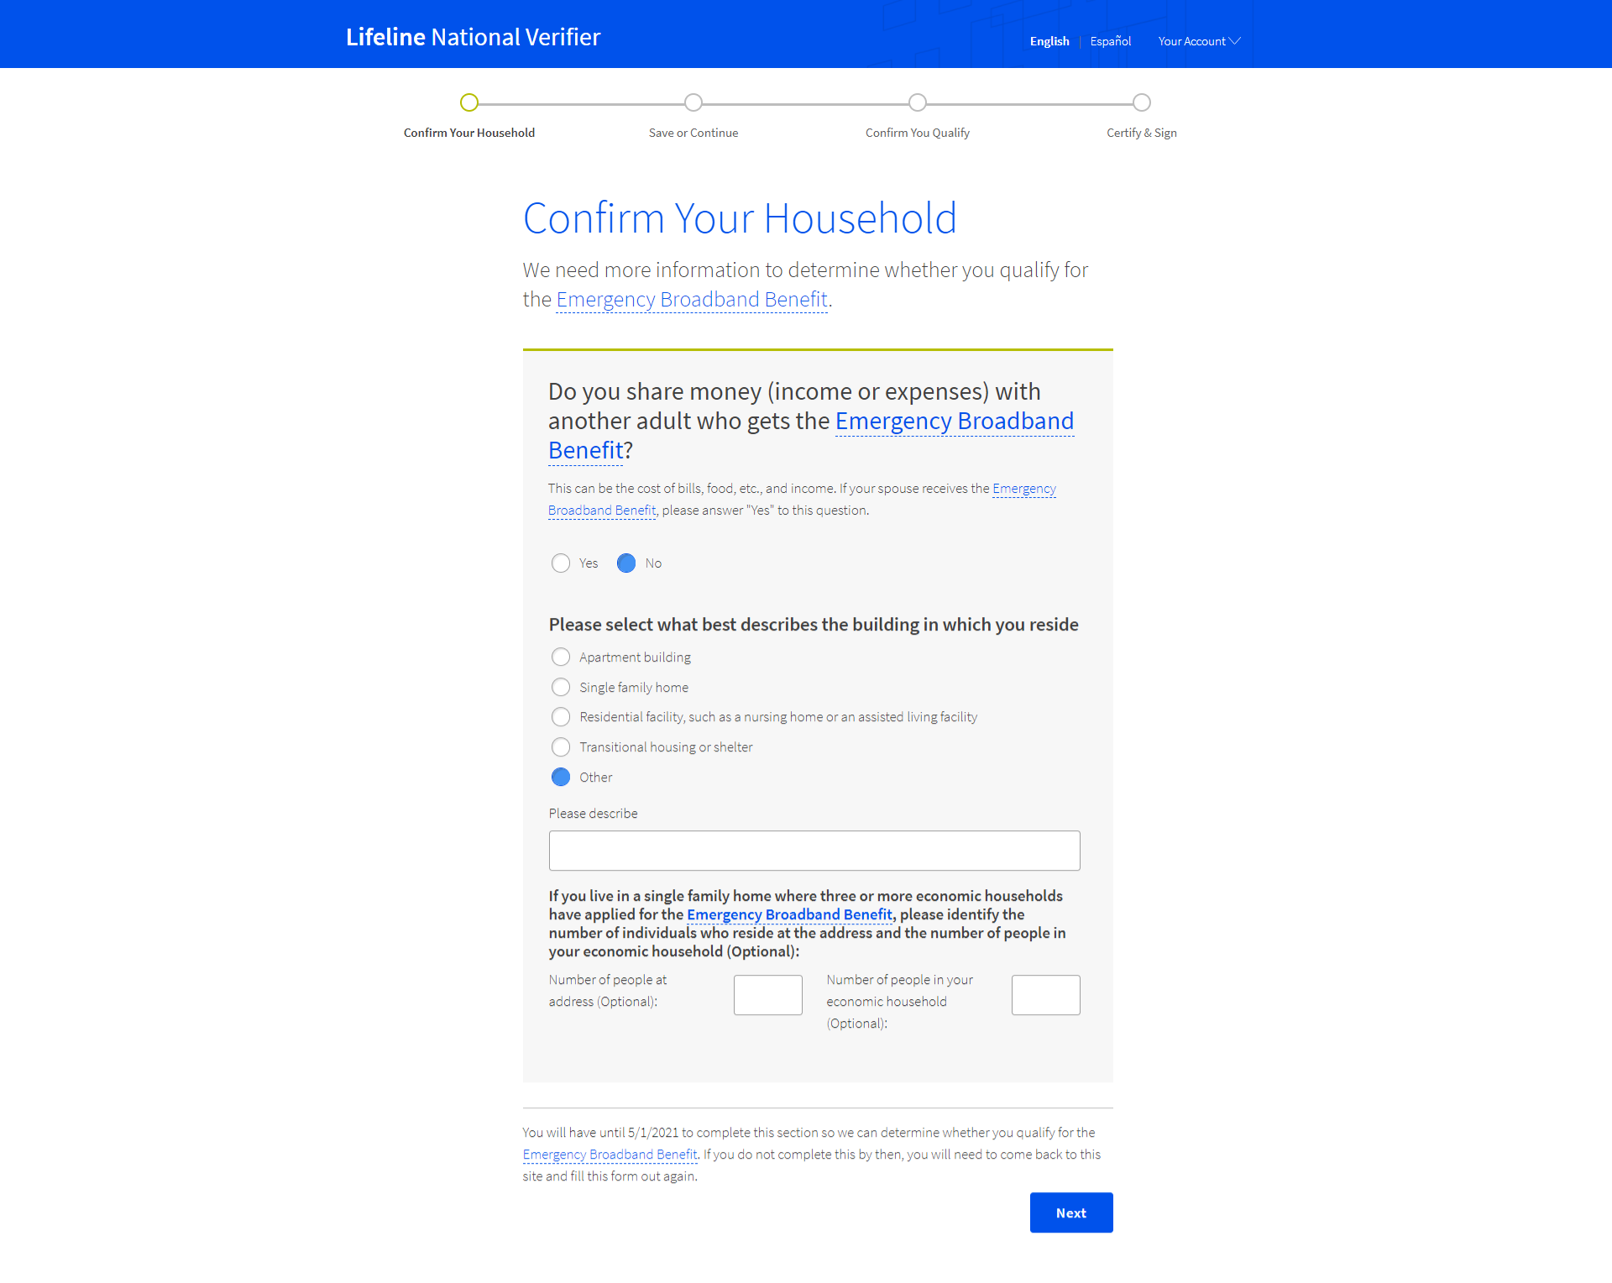
Apply Online
Notes:
When a consumer applies using a service address that already has a consumer receiving EBB service, the consumer has the opportunity to determine if they qualify as an independent economic household. By answering a short series of questions, the consumer can determine whether their household qualifies under the One per Household rule.

Slide 27
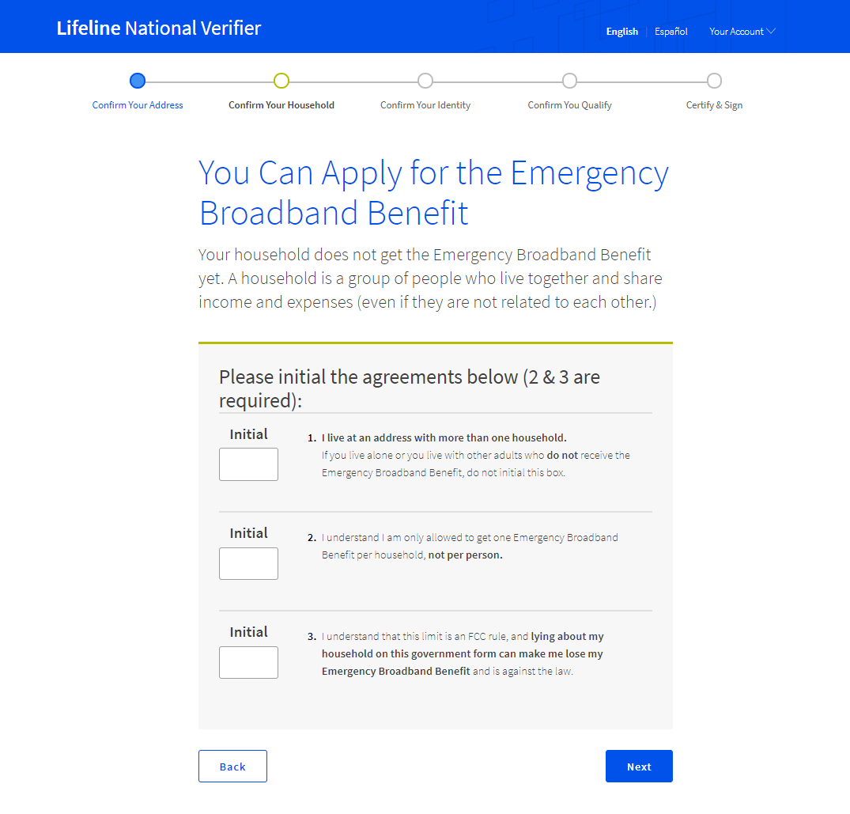
Apply Online
Notes:
If the household qualifies as an independent economic household, the consumer will initial three consent statements confirming that they are an IEH and that they understand the one per household rule.

Slide 28
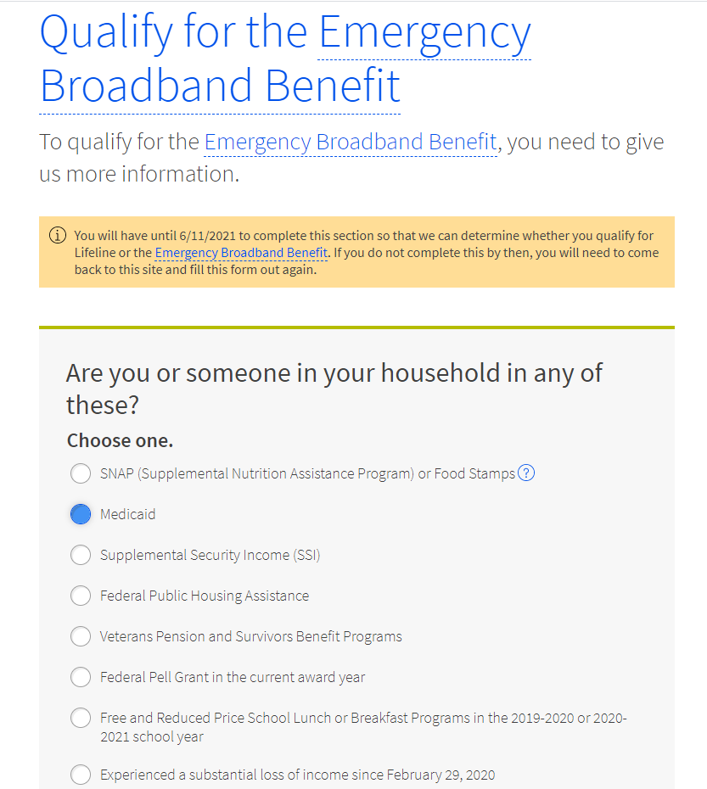
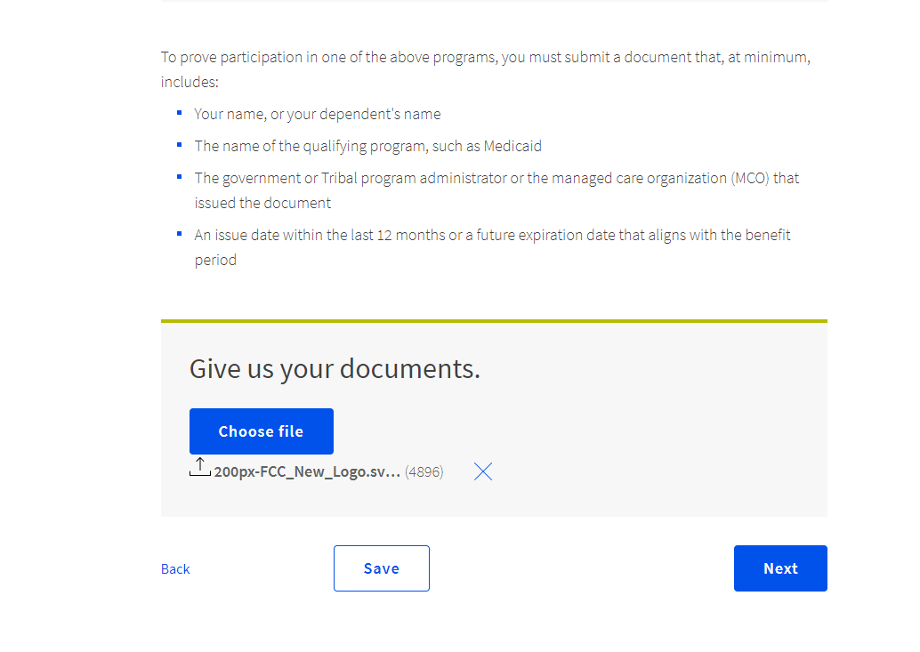
Apply Online
Notes:
If the EBB Program cannot determine eligibility, it will ask the consumer to upload documents. At this stage, the consumer selects the one program they’d like to use to qualify and then can upload a copy of their program documentation. On the screen, the consumer gets information about what the document should contain. The consumer can choose the file, and then upload it. When they click next, the documents are sent to the Emergency broadband support center for review.

Slide 29
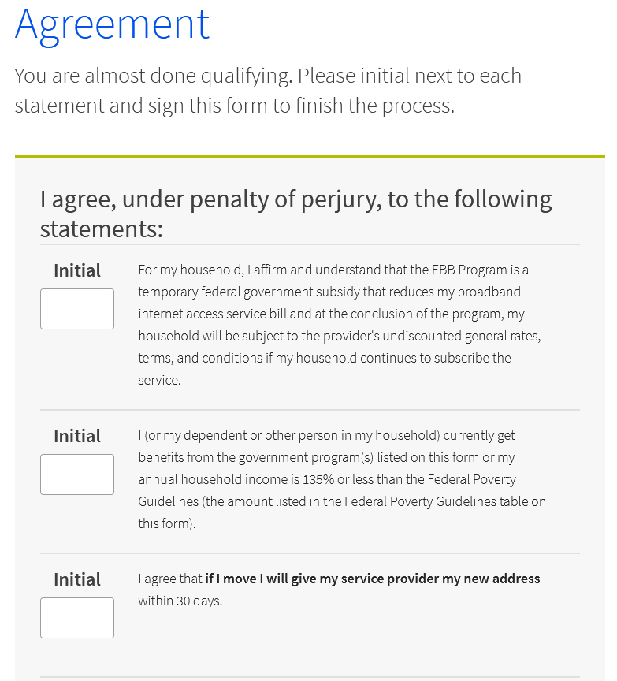
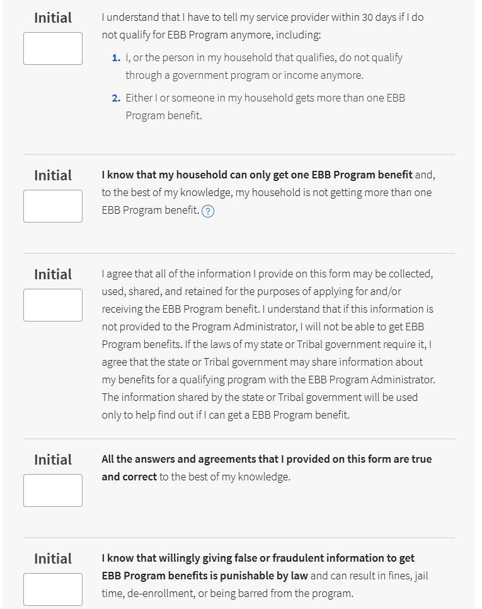
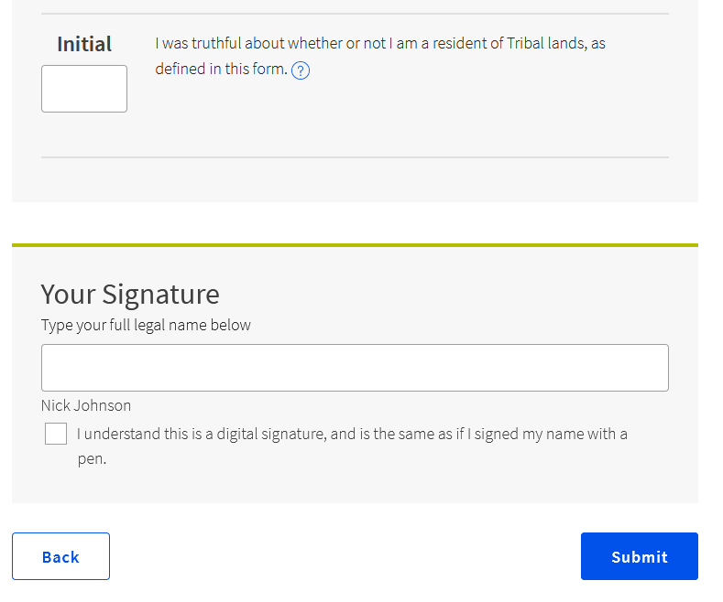
Notes:
Once the consumer has corrected all errors, they can initial and sign the program certifications. The consumer must complete this step themselves, even if someone is helping them complete the application.

Slide 30
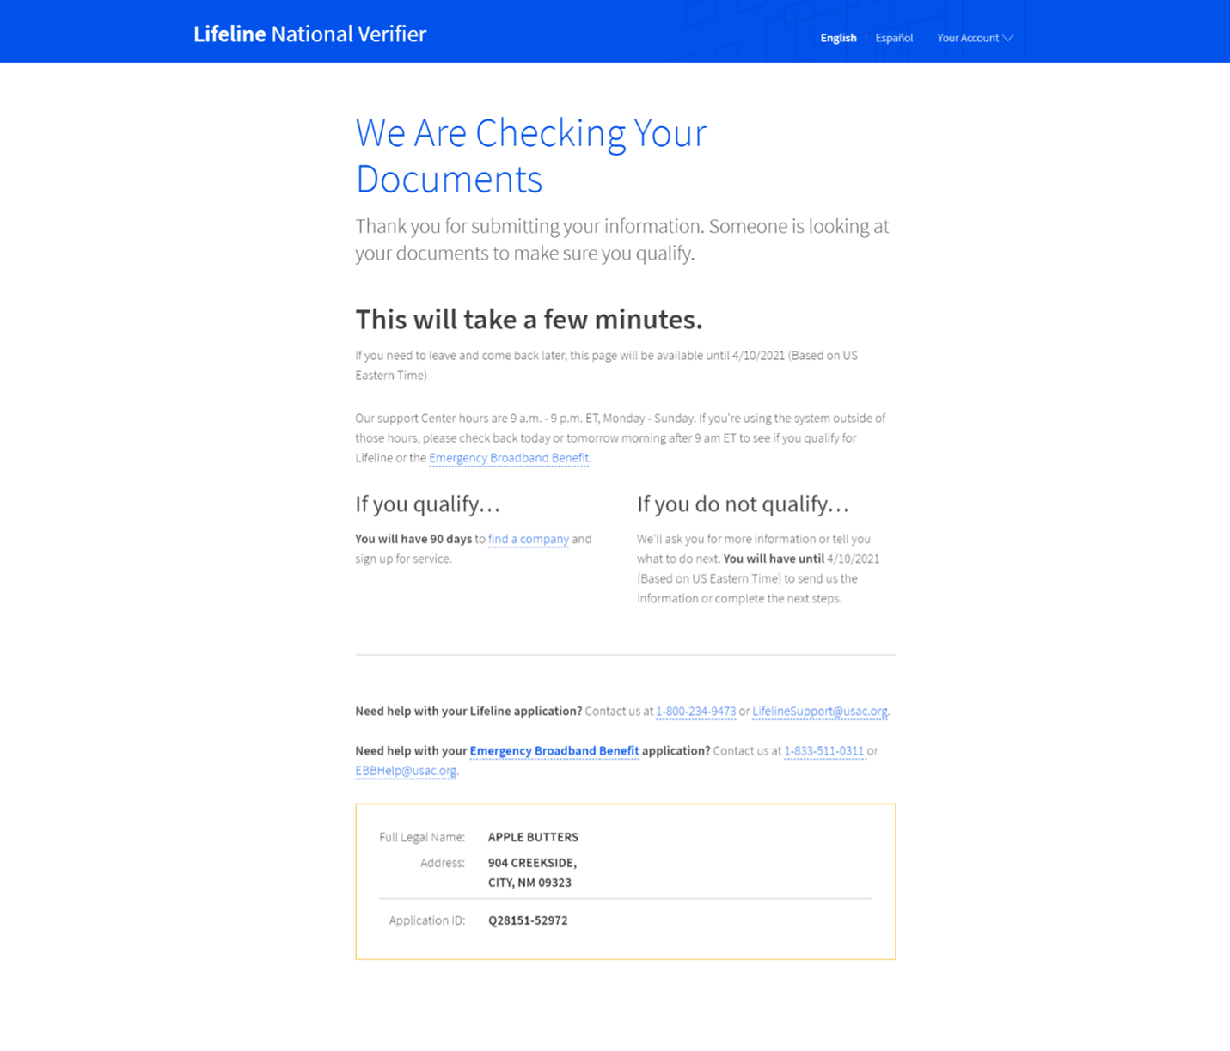
Apply Online
Notes:
After signing the certifications, the consumer gets a note that we are checking their documents. If it is outside of normal business hours, they receive a slightly different screen that lets them know when the EBSC will be back online. They can choose to stay on this screen during the wait, or leave and comeback later. If they stay, this screen will update when the check is complete.

Slide 31
Notes:
If the EBSC was able to confirm the consumer’s eligibility, the consumer will then receive the same success screen we reviewed earlier.

Slide 32
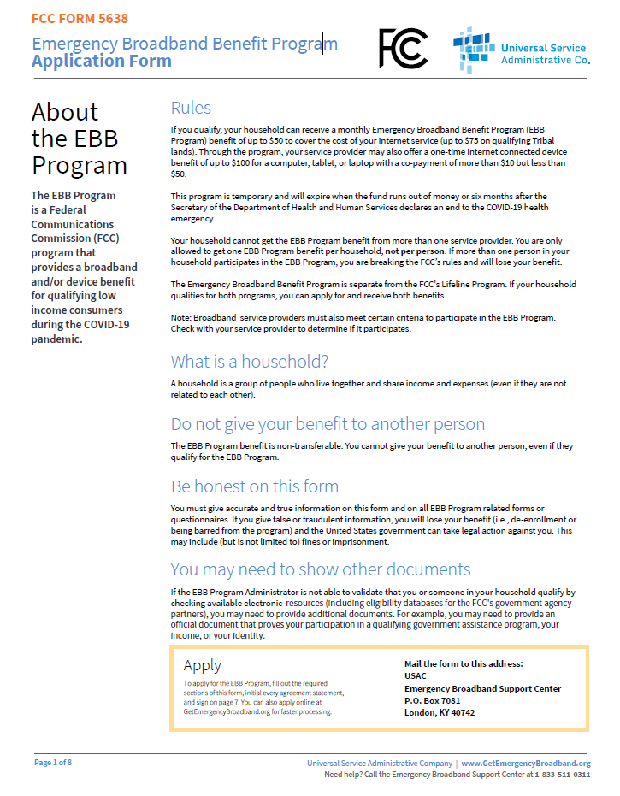
Apply by Mail
Consumers must complete all sections of the application (excluding page 8)
Write clearly, using black ink and capital letters
Consumers enter the same information they would include on the online application
Encourage consumers to submit copies of identity and eligibility documents along with a completed household worksheet
Notes:
Consumers who don’t have access to the online portal can apply using the paper application. We will collect the same information as we do in the online portal. We encourage consumers to use black ink and capital letters for easy processing. Because of the limited nature of the program, we strongly encourage consumers to include an email address if they have one and to submit copies of their identity and eligibility documents when they send in the application. Consumers should also submit a completed one per household worksheet for ease of processing.
After the consumer mails in their paper application, the EBSC will review and make an eligibility determination. If the consumer submitted an email, we’ll information them of the decision – or any errors that need correcting and how to do so – at the email address. If not, we’ll submit that information via mail to their mailing address.

Slide 34
Introducing the Emergency Broadband Benefit Outreach Toolkit
Lyle Ishida
Chief, Consumer Affairs and Outreach Division
Federal Communications Commission
lyle.Ishida@fcc.gov

Slide 35

The outreach toolkit is a collection of social media, printables, and other tools to assist communities, partners, grassroots organizers, and navigators in raising awareness around the Emergency Broadband Benefit.
These tools are for public access, downloadable, and free to use. They can also be co-branded and/or adjusted to your voice.

Slide 36

Social
Logos
Printables
Fact Sheet
Flyer
9”x 5” Info Card
1/4 Page Handout
Poster/Infographic
Videos and PSAs
ASL Video
Overview Video
How to Apply Video
Audio PSAs
Draft Social Media Posts
Newsletter Insert
Draft Press Release
Social Media Images
PowerPoint Slide Deck

Slide 37

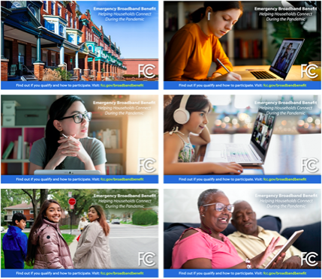
Logos
Social Media Images
Draft social Media Posts
Newsletter Inserts
Draft Press Release

Slide 38

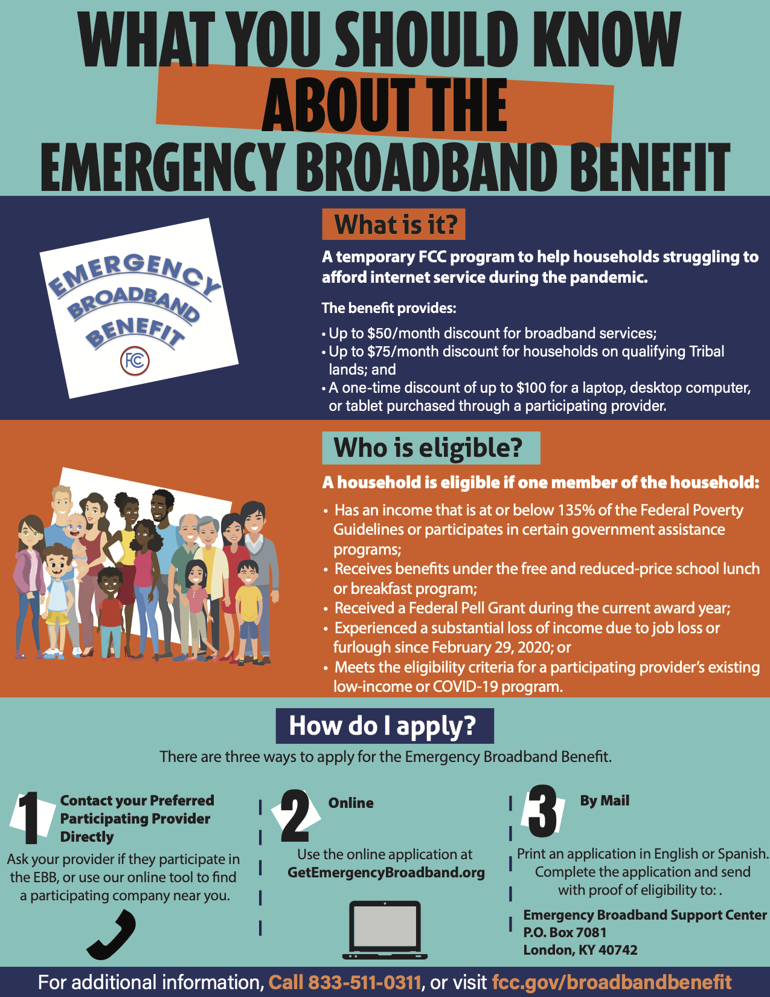
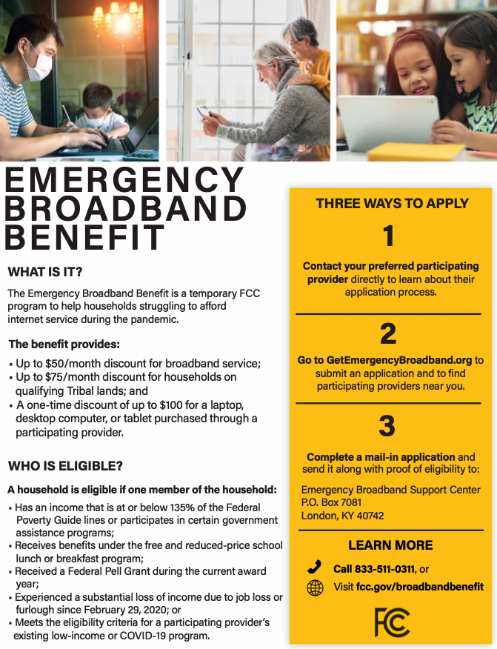
Fact Sheet
Flyers
Poster
9" x 5" Info Card
1/4 Page Handout
Infographic

Slide 39

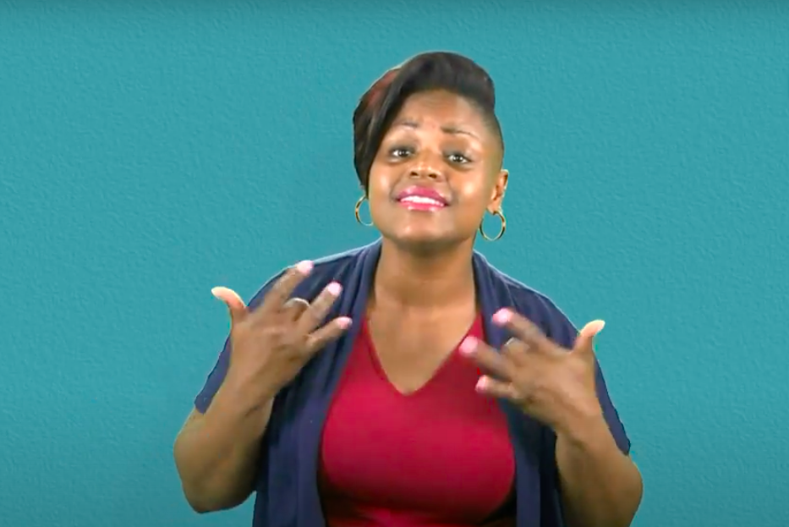
ASL Video
Overview Video
How to Apply Video
Radio PSAs
Powerpoint Slide Deck

Slide 40

Translated Languages
Arabic
Amharic
Burmese
Chinese (Traditional)
French
Haitian Creole
Korean
Portuguese
Russian
Somali
Spanish
Tagalog
Vietnamese
Translated Material
Fact Sheet
9" x 5" Info Cards
1/4 Page Handout
Alternate Formats
To request materials in accessible formats for people with disabilities (Braille, large print, electronic files, audio format), send an e-mail to: FCC504@fcc.gov.

Slide 41


The FCC’s EBB Consumer Page:
https://www.fcc.gov/broadbandbenefit
The FCC’s list, by state, of EBB providers
https://www.fcc.gov/emergency-broadband-benefit-providers
A comprehensive FAQ on the EBB program
https://www.fcc.gov/consumer-faq-emergency-broadband-benefit
Toll free number for questions: 833-511-0311
To apply: GetEmergencyBroadband.org

