Slide 1

Space Bureau Transparency Initiative:
Satellite Coordination
April 18, 2024

Slide 2



Outline
Space Bureau Coordination Guidance Documents
Introduction – Why coordinate?
ITU Radio Regulations
Coordination Types
The “CN” Coordination Process
The “AN” Coordination Process

Slide 3
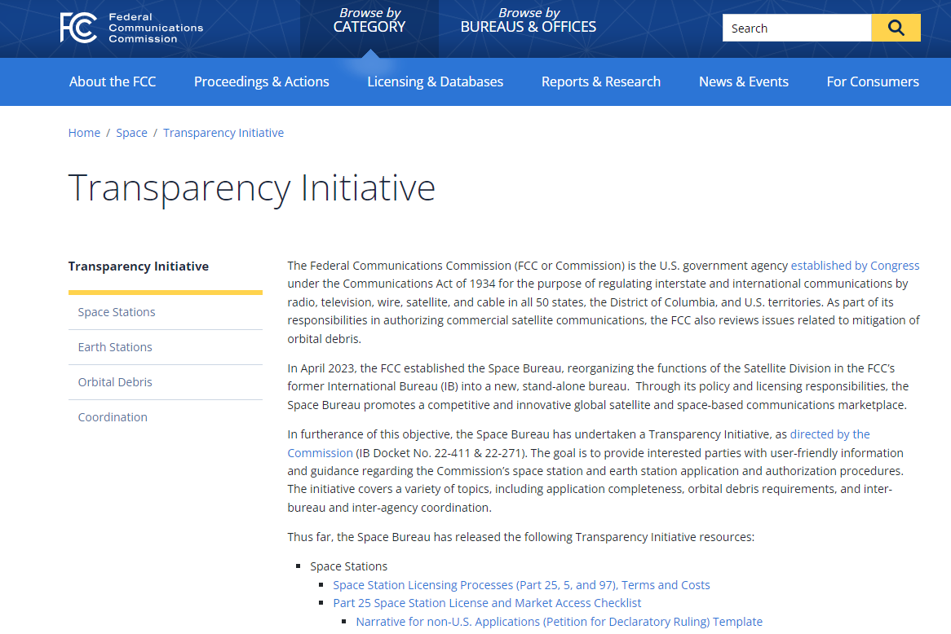
Space Bureau Coordination Guidance Documents

Slide 4
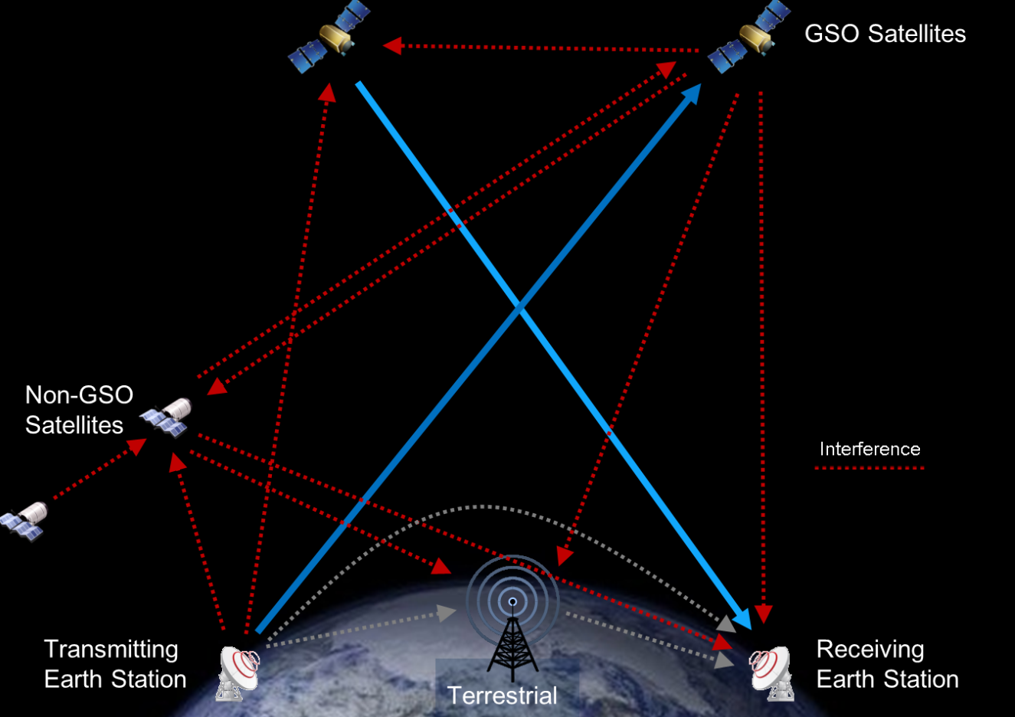
Why Coordinate?
Communications systems must coordinate to control and mitigate interference
Due to their distance from Earth, satellite beams often cover more than one country at a time
  Some frequency bands are shared between satellite services and terrestrial services, and each country can have its own frequency allocations
Figure from ITU WRS-22 “Overview of Space Services and Regulatory Framework”

Slide 5
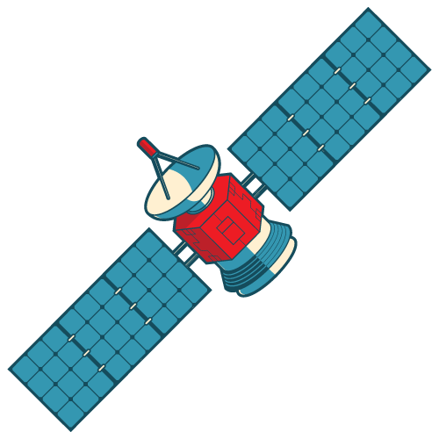
ITU Radio Regulations
ITU Radio Regulations provide the framework and procedures for satellite coordination and registration in the Master International Frequency Register (MIFR) in Chapter III
ITU RR Articles 7, 9, 11, 21, and 22 contain most of the procedures for coordinating in non-planned bands
Appendices 30, 30A and 30B contain the procedures for the planned satellite bands.
Coordination Elements (non-planned) | Relevant ITU Provisions
Procedures | Articles 9 & 11
Submission format | Appendix 4
Technical & operational limits | Article 5, 21, and 22
Criteria and methods to identify coordination requirements | Appendix 5, 7 and 8

Slide 6
Coordination Provisions for non-planned BSS or FSS networks
Case | Provision
GSO to GSO | 9.7, Article 7, AP30/30A/30B
Certain ES of GSO to NGSO | 9.7A
NGSO to Certain ES of GSO | 9.7B
BSS (GSO/NGSO) to Terrestrial Services | 9.11, Res. 539
NGSO to NGSO | 9.11A/9.12
NGSO to GSO | 9.11A/9.12A
GSO to NGSO | 9.11A/9.13
NGSO/GSO to Terrestrial Services | 9.11A/9.14
The requirement to seek the agreement of other administrations is included in a footnote to the Table of Allocations | 9.21
Table from ITU WRS-22 “Overview of Space Services and Regulatory Framework”

Slide 7
How does Coordination work?

Slide 8
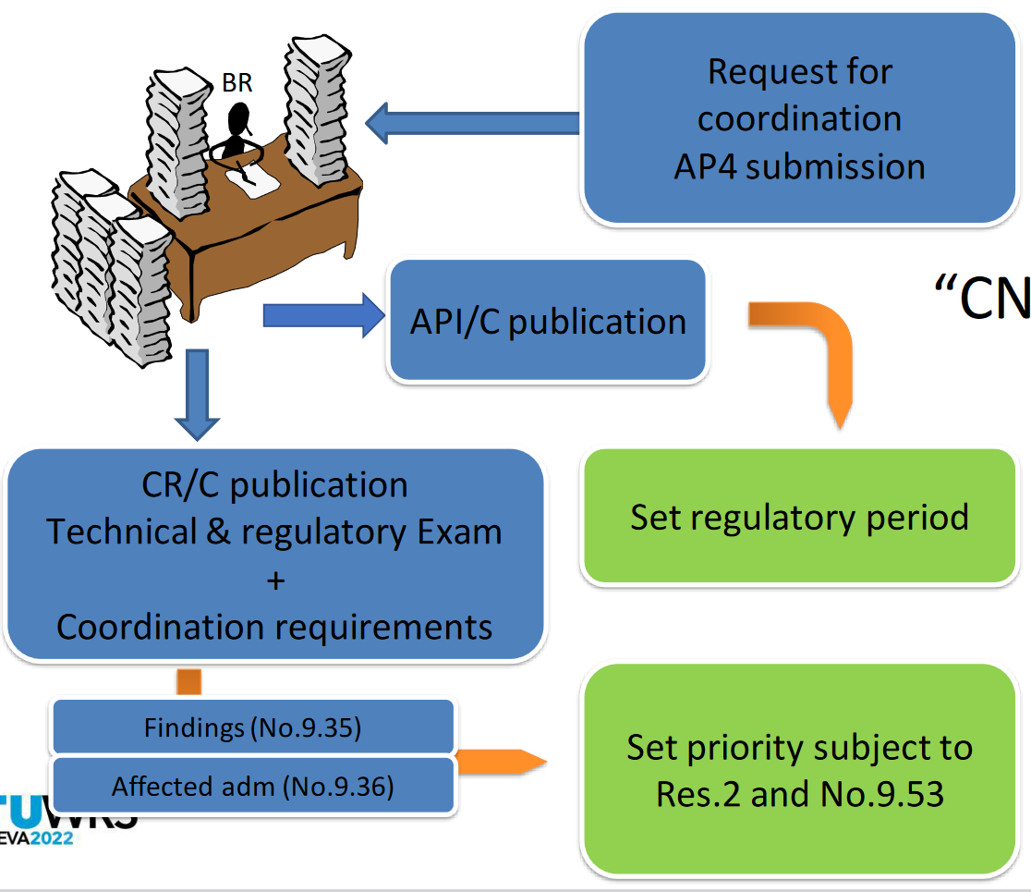
Coordination – Types and “CN” Procedure
“CN” Procedure for CR/C
Types of Coordination
“CN” procedure – the procedure for satellite networks subject to Section II of Article 9 Coordination Procedure
“AN” procedure – the procedure for satellite networks not subject to Section II of Article 9 Coordination Procedure (used by some NGSO)”
Figure from ITU WRS-22 “Overview of Space Services and Regulatory Framework”

Slide 9
Coordination Initiation
For satellite networks subject to Articles 9 and 11, the coordination process starts when an administration submits a coordination request (CR) to the ITU
Once the CR/C is received, the ITU reviews the material and publishes the Advanced Publication Information (API) in the IFIC
After a 4-month comment period, the ITU publishes the CR in the IFIC. This is at least 6 months after the date of receipt of the API.

Slide 10
Coordination Phase
Each admin reviews the BR IFIC and determines whether or not interference may be caused to, or by, its own assignments.
If interference may occur, the affected admin informs the ITU and the requesting admin. within the 4-month comment period
  Information concerning the satellite network(s) affected by the proposed network and a proposal for a solution to the issue is provided.
Requests for coord. should be acknowledged within 30 days from the date of receipt
Admins not responding to the BR IFIC within the 4-month comment period are treated as unaffected.
The ITU reviews comments from the admins using App 5 procedures and publishes the final list of affected admins whose networks will require detailed bi-lateral coordination

Slide 11
Coordinating and Notifying a Satellite Network
Coordination
Once the ITU finalizes the list of affected, the admin of the proposed network initiates coordination with the affected parties.
  This is can be done through correspondence or face-to-face meetings
When an agreement on coordination is reached, the administration responsible sends the Bureau information concerning the agreements.
For satellites operating in non-planned Bands, the satellite network must complete all coordination and be notified to the ITU within 7 years of the date of receipt of the API or the CR/C will be suppressed.
Notification
After coordination with affected admins is completed, notification filings are sent to the ITU
Filings include any Appendix 4 information updates
ITU reviews filings and enters the sat network in the Master International Frequency Register (MIFR)

Slide 12
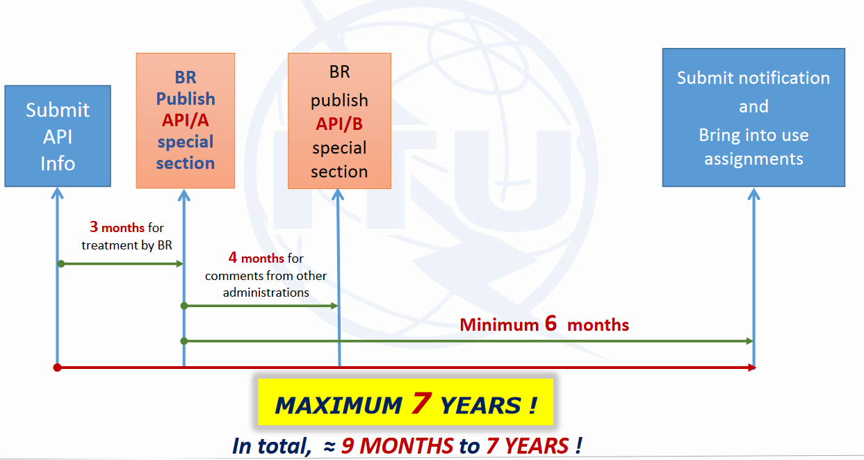
“AN” Procedure for Networks not subject to Coordination
Figure from ITU presentation to WRS-18 “Advance Publication Information (API) for satellite networks not subject to coordination”

Slide 13
“AN” Procedure
The provisions of Article 9, Sub-Section IA (API on satellite networks that are not subject to coordination procedure under Section II) are applicable
  Examples: Small sats that make use of frequencies not subject to coordination; GSO satellite networks with inter-satellite links operating with other NGSO space stations in bands not subject to coordination
These networks are subject to a commenting procedure and the resolution of potential interference specified under No. 9.3
  This procedure is not optional.
Comments to an API should be submitted within 4 months of the date of publication of the API special section in the IFIC
The Bureau will publish the list of admins which have sent comments in an API/B special section in an BR IFIC

Slide 14
Cooperation and Resolution of Potential Interference
Both administrations should cooperate in joint efforts to resolve any potential interference and shall exchange any additional relevant info that may be helpful
  In case of difficulties, the administration responsible for the planned satellite network should explore all possible means to resolve the potential interference without considering the possibility of adjustment to networks of other administrations
  If no such means can be found, it may request the other administrations explore all possible means to meet its requirements
  Either party can request assistance of the Radiocommunications Bureau (No. 9.3)
The admins concerned should make every possible effort to resolve the potential interference
Notification Procedures
After the resolution of the potential interference through coordination, the network may be notified and added to the MIFR
  This process is the same as for the “CN” procedure

Slide 15
Conclusion
Contact Information:
satinfo@fcc.gov

