Slide 1
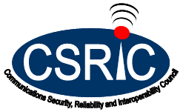
Working Group 10: Legacy Systems and Services Risk Reduction Status Update
March 15, 2017
John Kimmins, Co-Chair, iconectiv
Danny McPherson, Co-Chair, Verisign
FCC Liaison: Steven McKinnon

Slide 2
WG10 Objectives
Working Group Description:
In the Technology Transitions Order of August 2015, the Commission notes that “communications are rapidly transitioning away from” TDM-based technologies to “new, all-IP multimedia networks.” The intermingling of legacy communications technologies with advanced communications technologies introduces new threat vectors and cyber risk. Recently, this issue has gained greater attention in light of the security threats to Signaling System 7 (SS7) and its IP based version SIGTRAN, a signaling protocol supporting call setup, routing, exchange, and billing functions in communications networks by sending messages between fixed and mobile communications service providers. The scale of SS7, which is used by carriers all over the world, means that every network subscriber could be vulnerable to these security risks.
As part of a series of requests to CSRIC, the Commission asked CSRIC to examine vulnerabilities associated with the SS7 protocol and other key communications protocols (e.g., Diameter). CSRIC Working Group 10 will assess existing and potential threats and current defensive mechanisms and make recommendations to the FCC on how to overcome security challenges present in SS7 and other communications protocols used between communications networks and their impact on the transition to next generation networks. The first step is the development of a Risk Assessment and Summary Report as described herein.
Deliverables: Risk Assessment and Final Report

Slide 3
WG10 Members
John Kimmins, Co-chair (iconectiv)
Danny McPherson, Co-chair (Verisign)
Steven McKinnon, FCC Liaison
Name | Company
Kathy Blasco | DHS
Kevin Briggs | DHS
Shawn Clark | Comcast
Martin Dolly | ATIS
Mark Easley | AT&T
Joshua Franklin | NIST
John Gallagher | Sprint
Mohammad Khaled | Nokia
Philip Linse | CenturyLink
Tim Lorello | Seculore Solutions LLC
John Marinho – Lead Editor | CTIA
Drew Morin | T-Mobile
Donald Morris-Jones | DHS
Dave Nolan | DHS
Nilesh Ranjan | T-Mobile
Travis Russell | Oracle Communications
Xiaomei Wang | Verizon Wireless
Kathy Whitbeck | Nsight
Subject Matter Experts (SMEs):
Nokia Bell Labs, Silke Holtmanns
Security Research Labs, Karsten Nohl
Adaptive Mobile, Brian Collins
3

Slide 4
WG10 Final Deliverables
Risk Assessment Report
December 21, 2016
Restricted Version with Attack Scenarios
Public Version with Redacted Sections
Summary Report & Recommendations
March 2017

Slide 5
Risk Assessment Focus
Telecom Network & Signaling Technologies Background
Threat Landscape
Risk Assessment
Risk Detection & Mitigation
Global Assessment
Conclusions

Slide 6
Risk Assessment Key Points
Overwhelming amount of SS7 traffic is legitimate
Assessed different attack methodologies documented & discussed in different settings, e.g., conferences, industry forums
Attacks have exploited legacy interconnected trust ecosystem for signaling access
More coverage, networks and participants have increased the probability that this trust will be exploited
Changing business & geo-political factors have played a role in increasing frequency and volume of targeted attacks

Slide 7
Risk Assessment Key Points (Continued)
Attack vectors indicate a focus on different motivations including potential tracking, interception, fraud and Denial-of-Service of a targeted individual or groups of individuals
Service companies need to be measured in their response to avoid collateral network impacts to legitimate traffic
Different products and capabilities have been implemented to counter known attacks
Industry groups (e.g., GSMA) and standards forums (e.g., 3GPP) are providing key security guidance and specifications

Slide 8
Conclusions & Recommendations
Future CSRIC Efforts
There are major areas that need further study to identify potentials threats and vulnerabilities and appropriate countermeasures
Recommendations for the FCC:
FCC should consider the following areas for future CSRIC efforts:
Diameter and 5G networks
Circles of Trust
Non-GSMA signaling systems such as : AIN, SIP, ANSI-MAP

Slide 9
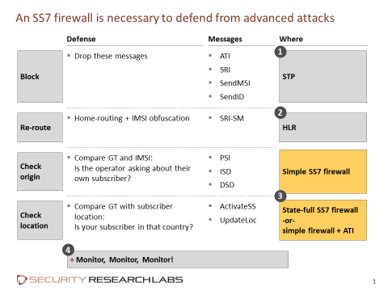
Conclusions & Recommendations
Signaling Interconnection Monitoring and Filtering
Most effective mechanism to mitigate risks and impact
Example of one approach to address SS7 attacks
Recommendations for Industry:
Industry should continue to implement interconnection monitoring and filtering
WG endorses GSMA security best practices and guidelines for SS7 and Diameter

Slide 10
Conclusions & Recommendations
Signaling Aggregators
Wider view of traffic originating from domestic and international entities terminating in the U.S. telecommunications network
Recommendation for Industry:
Industry should engage aggregators in their efforts to address overall signaling security, monitoring and filtering
Threat Information Sharing
Sharing incidents helps adapt security mechanisms to address evolving attack vectors and support security business cases
Recommendations for Industry:
Industry should continue to leverage and expand information sharing resources as outlined in WG 5 report
Industry should continue efforts regarding automated threat information sharing CTIA sponsored Pilot

Slide 11
Conclusions & Recommendations
Emerging Diameter & 5G Networks
As Diameter and 5G network virtualized infrastructures becomes more widely deployed they will become targets and potentially impact U.S. Critical Infrastructure
Recommendation for Industry:
Industry should continue to participate in standards forums and adopt GSMA recommended Diameter controls
Circles of Trust
Trust Groups framework among peer carriers could be beneficial to managing security controls across different interconnection points
Recommendation for Industry:
Industry should continue to explore further work to identify potential benefits

Slide 12
Conclusions & Recommendations
Ongoing Security Assessment of Signaling Infrastructure
It is important to maintain robust security controls across the carrier’s signaling infrastructure
Recommendation for Industry:
Industry should continue its efforts of ongoing security assessments to detect and mitigate possible threat vectors
Subscriber Encryption Support
Mobile calls are delivered in the clear and are potentially susceptible to interception
Recommendation for Industry:
Industry should encourage the use of available encryption technologies for both voice and data communications for highly sensitive applications and VIPs

