Slide 1
Seventh Meeting of THE COMMUNICATIONS SECURITY, RELIABILITY, AND INTEROPERABILITY COUNCIL VIII
March 21, 2023

Slide 2
Open Meeting & Welcome Suzon Cameron, DFO

Slide 3
Opening Remarks
CSRIC VIII Co-chair
Nasrin Rezai, Verizon

Slide 4
Presentation
Report on 911 Service over Wi-Fi
WG4: Co-chairs
Mary Boyd, Intrado
Mark Reddish, APCO

Slide 5
Working Group 4: 911 Service Over Wi-Fi Final Report
March 21, 2023
Co-chairs:
Mary Boyd, Intrado Life & Safety
Mark Reddish, APCO
FCC Liaison: Rasoul Safavian

Slide 6
Working Group 4: Background
The Chairwoman of the FCC directs CSRIC VIII to explore the public safety benefits, technical feasibility, and cost of options for making Wi-Fi access points and/or unlicensed spectrum available to the public to facilitate access to 911 services. The ubiquitous nature of Wi-Fi access points suggests that, in the long term, various Wi-Fi solutions could be added to the “toolbox” of 911 connectivity options available to consumers, Public Safety Answering Points (PSAPs), and communications providers, and could complement the broader transition to an IP-based Next Generation 911 environment.

Slide 7
Working Group 4: Objectives
Bring industry stakeholders together to examine a range of technical issues with the goal of promoting consensus in the Wi-Fi ecosystem to support reliable 911 services (voice and text) under normal conditions and when catastrophic events disrupt mobile service. The primary focus will be to:
examine and report on security issues including authentication and access control protocols, solutions to automatically activate Wi-Fi Calling on eligible mobile devices, when necessary;
automatically determining the 911 caller location and call routing issues, 911 call prioritization, identifying missing standards, and timelines and costs for implementing 911 over Wi-Fi solutions.

Slide 8
Working Group 4: Members
Co-chairs: Mary Boyd,* Intrado
Mark Reddish,* APCO
Brandon Abley,* National Emergency Number Association
Rob Alderfer,* Charter Communications
Mark Annas,* City of Riverside Fire Department, OEM
Michael Bergman,* Consumer Technology Association
Wade Buckner,* International Association of Fire Chiefs
Kirk Burroughs, Apple
Chinmay Dhodapkar, Google LLC
Stephen Edge, Qualcomm Technologies, Inc.
Katherine Elkins,* NHTSA
Harold Feld,* Public Knowledge
Fred Frantz, ANDRO Computational Solutions
Mark Gibson, CommScope
James D. Goerke, Texas 9-1-1 Alliance
Jeanna M. Green, T-Mobile
Kevin Green, Somos, Inc.
Mark Grubb, CISA
Mark Hess,* Comcast Corporation
Craig Hodan,* National Weather Service/NOAA
Everett Kaneshige,* NATOA
Robert Kubik, Samsung Electronics America
William 'Andy' Leneweaver, Washington State Military Department
Jason Lish,* Lumen Technologies, Inc.
William Mikucki, Comtech Telecommunications
Susan Miller,* ATIS
Charles (“Peter”) Musgrove, AT&T, Inc.
Theresa Reese, Ericsson
Travis Reutter,* ACA Connects- America's Communications Association
Charlie Sasser, National Association of State Technology Directors
Tim Schram,* NARUC
Sean Scott,* SecuLore Solutions
Malcolm Smith, Cisco Systems, Inc.
Stuart Strickland, Hewlett Packard Enterprise
Jeff Torres, Verizon Communications
Steve Watkins,* Cox Communications
Jeffrey Wittek, Motorola Solutions
FCC Liaison: Rasoul Safavian
*Also a CSRIC VIII Member

Slide 9
Working Group 4: Alternates & Subject Matter Experts*
Chris Anderson, Lumen Technologies, Inc.
Carol Ansley, Cox Communications
Scott Blue, Cisco
Tom Breen, SecuLore Solutions
Matthew Chappell, Cox Communications
Justen Davis, Somos, Inc.
Nicholas Garcia, Public Knowledge
J. David Grossman, CTA
Michael Hooker, T-Mobile
Brian Hurley, ACA Connects
Christian Militeau, ATIS
Darrin Morkunas, Intrado
James B. Ramsay, NARUC
Praveen Srivastava, Charter Communications
Megan Stapleton, Comtech Telecommunications
Brian Tegtmeyer, NHTSA
Peter Thornycroft, Hewlett Packard Enterprise
Alison Venable, APCO
Subject Matter Experts
Mark Grayson, Cisco
Pat Welsh, Intelsat,
Peter Davidson, Intelsat
Sri Gundavelli, Cisco
* Alternates are not a member of the Working Group and may not vote.

Slide 10
Working Group 4: Structure
Full Working Group
Sub-Teams :
Technical Feasibility
Public Safety Benefits
Cost Analysis
General Meeting Schedules:
Weekly / Bi-Weekly /Monthly

Slide 11
Working Group 4: Report Framework
Executive Summary
Objective, Scope & Methodology
Identification of public safety principles and a framework for analyzing costs.
Current State of 911 Over Wi-Fi
Analysis, Findings & Recommendations
Technical review of current and potential 911 over Wi-Fi use cases
Conclusions

Slide 12
Working Group 4: Scope
Focus was placed on the analysis and reporting of:
Security issues, including Wi-Fi authentication and access control protocols;
Solutions to automatically activate 911 Wi-Fi Calling on eligible mobile devices with active subscriptions, when necessary;
Automatic determination of the 911 caller location and discussion of call routing issues;
911 call prioritization;
Missing standards; and
Timelines and costs for implementing 911 over Wi-Fi solutions.
Other considerations include:
Limiting access to only 911 service;
Turning Wi-Fi Calling off after 911 use;
Wi-Fi mobility;
Dedicated Passpoint profile for emergency services;
Callback issues; and
Power and backhaul issues in cases of natural disasters.

Slide 13
Working Group 4: Public Safety Perspective
Criteria/features for evaluating public safety benefits for Wi-Fi 911 call delivery in the context of the Report’s use cases:
Connect the 911 call to the appropriate PSAP/ECC
Maintain the 911 call
Provide the current caller location data
Support callback capability
Authentication of caller identity associated with 911 Calls
Provide a Wi-Fi calling designation

Slide 14
Use Cases
Current-state
#1 - 911 call over Cellular Network – Home network
#2 - 911 call over Cellular Network – Domestic and International Roaming (full service)
#3 - 911 call over Cellular Network – Domestic and International Roaming (limited-service)
#4 - 911 call over Cellular Network – NSI Device
#5 - 911 call over Wi-Fi without cellular coverage
Potential enhancements
#6 - Emergency Access to Nearby Wi-Fi AP
#7 - Automatic Activation of Wi-Fi Calling
#8 - 911 over Wi-Fi from a device with an International subscription
#9 - Emergency Access to nearby Wi-Fi AP when cellular RAN, Core and IMS are not available
#10 - Emergency Access to nearby Wi-Fi AP when cellular RAN, Core and/or IMS are not available using a framework allowing the use of a default Emergency Passpoint profile

Slide 15
Recommendations to the FCC
The Commission should gather and maintain accurate information about device and network settings related to 911 over Wi-Fi and ensure this information is available to consumers.
Consult with the Federal Aviation Administration, airlines, Commercial Mobile Radio Service (CMRS) providers, and other stakeholders to consider the need for rules or standards to govern if/when calls/texts to 911 via airplane Wi-Fi should be permitted.
The Commission should evaluate the applicability of rules for various 911 over Wi-Fi use cases.
Consider the need to clarify that entities will not incur new obligations as a function of developing technologies and standards that enable 911 service over Wi-Fi.
Consider the need for clarification of which entities have obligations to provide 911 service and other obligations.

Slide 16
Recommendations to the FCC (cont.)
Direct a future CSRIC working group to assess the ability for 911 service over Wi-Fi and EPCS NS/EP priority access to coexist and determine if it is necessary to provide more specific recommendations prior to ubiquitous deployment of EPCS.
Consider opening a proceeding on automatic (phone) device support for Wi-Fi calling for emergency calls when it has not been enabled on the device and cellular service is not available….., the length of time that Wi-Fi calling should remain active should be analyzed and recommended as an industry standard.
If an MNO is not available to allow access to emergency services, the FCC should investigate methods to access emergency services to be designated to handle Wi-Fi-enabled 911 calls, along with an IDP function for a new interconnecting network realm dedicated to connecting emergency services from the Internet to emergency services networks.

Slide 17
Recommendations to the FCC (cont.)
Consider repealing the requirement to collect Registered Location information for non-fixed interconnected VoIP services at service initialization given the advancements in location determination, and to allow for the automatic enabling of Wi‑Fi calling.
Consider the need for clarifying the rules to ensure the use of location-based routing and delivery of the best-available location information for 911 calls over Wi-Fi.
To address roaming issues the FCC should:
Determine the current state of VoLTE and VoNR interoperability for emergency calling purposes for devices that are operated in the United States, where feasible;
Explore methods to improve access to domestic emergency services for foreign visitors;
Determine the feasibility of Wi-Fi calling origination, particularly and specifically in the case of an international visitor’s device originating a call over a Wi-Fi connection; and
Collaborate with international bodies to harmonize any such rules as described above.

Slide 18
Recommendations to Industry/Other
It is recommended that service providers, Public Safety professionals, and other 911 stakeholders participate in the development of standards-based location spoofing mitigation solutions that will support PSAPs/ECCs in assessing, in real-time, the legitimacy of location information associated with 911 calls, including 911 calls originated over Wi-Fi.
Concerning Service Continuity: Given the public safety benefits of maintaining a 911 call when a caller moves outside of the serving area of the cell or Wi-Fi access point to which the call is initially connected, CSRIC VIII recommends the following:
Industry bodies and individual companies should continue developing and implementing methods for seamless mobility between APs and between APs and cellular networks.
Further consideration, including the need for industry standards, should be given by device manufacturers (OEMs) regarding policies and methods for turning on device Wi-Fi and turning off Airplane Mode when a 911 call is made.

Slide 19
Recommendations to Industry/Other (cont.)
It is recommended that service providers, Public Safety professionals, and other 911 stakeholders participate in the development of a standards-based solution that will convey a Class of Service (COS) or other designation for 911 calls that originate over Wi-Fi to PSAPs/ECCs.
The working group encourages appropriate standards bodies to conduct continued performance modeling and studies to ensure that any future 911 service identification over Wi-Fi and forthcoming EPCS NS/EP priority access can coexist with minimal effect on either service.
Industry bodies should establish standards and best practices for location-based routing and the provision of location information to complement the current regulatory framework including those for non-fixed VoIP services.
If emergency Passpoint profile access to APs (enterprise, residential, public access point) is supported, then AP vendors should support an opt-in capability for such emergency access to the AP, provided that appropriate assurance is made that access is limited to emergency calling.

Slide 20
Conclusion
This report explores the opportunity to leverage the ubiquitous nature of Wi-Fi access points to support 911 connectivity options available to consumers.
It also represents the most comprehensive public documentation to date of the existing capabilities and limitations of 911 service over Wi-Fi, and it analyzes the public safety benefits, technical feasibility, and potential costs associated with improving access to 911 with Wi-Fi access points.
CSRIC VIII looks forward to the Commission and other entities acting upon the recommendations detailed in this report to expand 911 service over Wi-Fi with appropriate consideration of security challenges, technical feasibility, and public safety needs.

Slide 21
Discussion
Report on 911 Service over Wi-Fi
WG4: Co-chairs
Mary Boyd, Intrado
Mark Reddish, APCO

Slide 22
Call For Vote
Report on 911 Service over Wi-Fi
WG4: Co-chairs
Mary Boyd, Intrado
Mark Reddish, APCO

Slide 23
Presentation
Report on WEA Application Programming Interface
WG6: Co-chairs
Farrokh Khatibi, Qualcomm Francisco Sanchez, SBA

Slide 24
Working Group 6: Leveraging Mobile Device Applications and Firmware to Enhance Wireless Emergency Alerts
March 21, 2023
Co-chairs:
Farrokh Khatibi, Qualcomm Technologies, Inc.
Francisco Sanchez, U.S. Small Business Administration (SBA)
FCC Liaison: James Wiley and Tara Shostek

Slide 25
Working Group 6: Deliverables/Schedule
Report on WEA Performance Reporting, December 2022
Report on WEA Application Programming Interface, March 2023

Slide 26
Working Group 6: Members
Co-chairs: Farrokh Khatibi,* Qualcomm
Francisco Sanchez,* U.S. Small Business Administration (SBA)
Mark Annas,* City of Riverside Fire Department, OEM
Rebecca Baudendistel, NYC Emergency Management
Terri Brooks, T-Mobile
Wade Buckner,* International Association of Fire Chiefs
Kirk Burroughs, Apple
Brian K. Daly,* AT&T, Inc.
Harold Feld,* Public Knowledge
Craig Fugate,* America’s Public Television Stations
Michael Gerber, NOAA/National Weather Service
Dana Golub,* Public Broadcasting Service
Stephen Guiwits, US Geological Survey
Mark Hess,* Comcast Corporation
Antwane Johnson,* FEMA
Robert Kubik, Samsung Electronics America
Jennifer Lazo, City of Los Angeles Emergency Management Dept.
John Marinho, CTIA
Susan Miller,* ATIS
Nathanael Scherer, American Consumer Institute
Matthew Straeb, Global Security Systems, LLC
Peter Tomczak,* FirstNet Authority
Dara Ung, Comtech Telecommunications Corp.
Larry Walke, National Association for Broadcasters
Steve Watkins,* Cox Communications
Chia-Kaung (Jack) Yu, Google LLC
FCC Liaisons: James Wiley
Tara Shostek
*Also a CSRIC Member
Editor: Terri Brooks

Slide 27
Working Group 6: Alternates*
Tim Dunn, T-Mobile
Nicholas Garcia, Public Knowledge
Kevin Green, FirstNet Authority
Al Kenyon, FEMA
Charles (“Peter”) Musgrove, ATIS
Peter Scott, PBS
* Alternates are not a member of the Working Group and may not vote.

Slide 28
Objective
CSRIC VIII has been charged with forming recommendations for the software or functional requirements necessary to allow Wireless Emergency Alert (WEA) software to pull capabilities from other mobile device applications, native OS functionality, and firmware to improve the effectiveness of WEA messages, including an Application Programming Interface (API) for this purpose.

Slide 29
Executive Summary
The WEA system serves a critical function, disseminating important and often life-saving information. While information is included in the alert text to assist the user, there may be opportunities to enhance the effectiveness of the alert via new or existing capabilities on mobile devices.
The report explores the following proposals, which provide the opportunity to enhance the WEA user experience:
Alert Area Graphic
Dedicated Audio Attention Signal(s) for Critical Response Time Alerts
WEA Event-Based Notifications
Expanded Language Set for WEA
WEA Handling of Threats in Motion
The report documents the analysis produced by the CSRIC VIII with respect to these proposals, including recommendations for an API to leverage mobile device applications, native Operating System (OS) functionality, and firmware that could enhance WEA’s presentation of emergency information to the public. This includes aspects related to security of WEA message content and protection of consumer privacy. The report also identifies potential impacts to the timely deployment of an API.

Slide 30
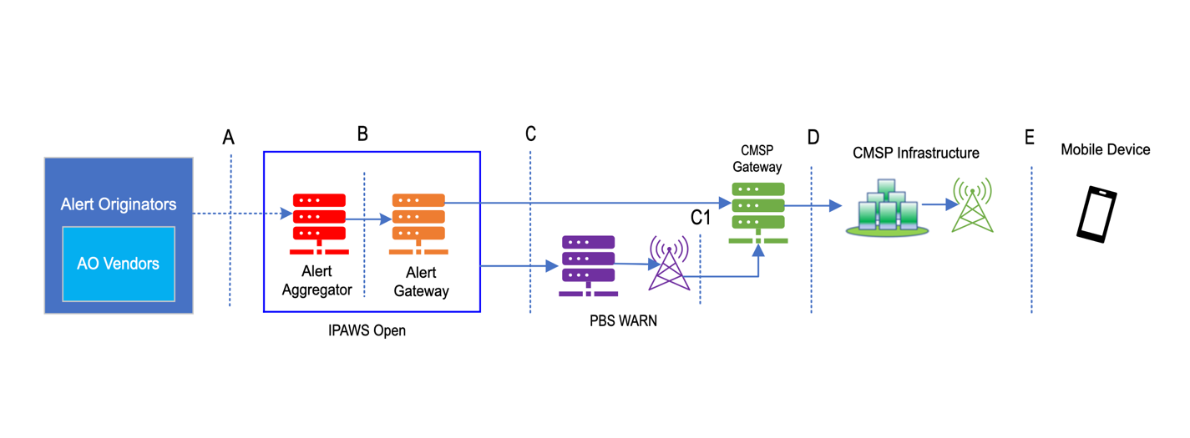
Wireless Emergency Alert System

Slide 31
Types of Applications on Mobile Devices
An application (App) is a computer software program most commonly used to perform a specific function for a user or another application. “Apps” in this report refers to those used on mobile devices. There are different types of Apps including:
System Apps – The Apps that are part of the mobile operating system. System Apps must have the same signature of the mobile operating system and are the most trusted Apps on the mobile devices.
First party Apps – The Apps that are developed by the first party (e.g., Apple, Google) that also develops the mobile operating system (e.g., Google Maps, Apple Maps).
Privileged Apps – The Apps that are developed by the third party but designated by the mobile device manufacturers to be pre-installed on the devices out of the box. Privileged Apps are less secured than the System Apps and First party Apps.
Third party Apps – The Apps that can be downloaded through an App store (e.g., Apple App Store, Google Play App Store). These Apps are developed by third party developers and are normally less secured than System Apps and Privileged Apps.

Slide 32
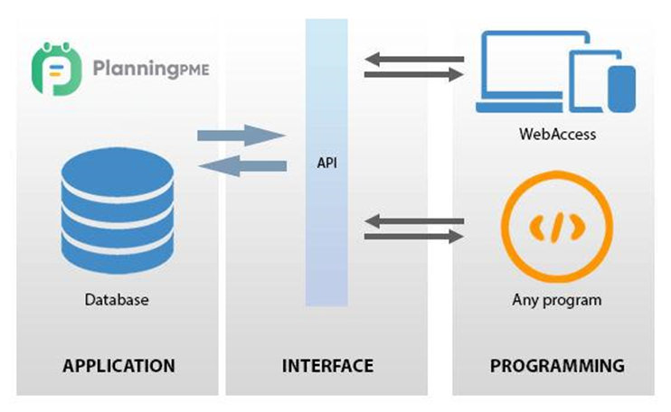
Application Programming Interface (API)
An API is an interface that allows two Apps to communicate with each other:
In the case of WEA, an API could allow Apps to:
Access the real-time emergency alerts information including message content, device location, time, etc.
Provide additional capabilities based on the received information, such as real-time translation to different languages.

Slide 33
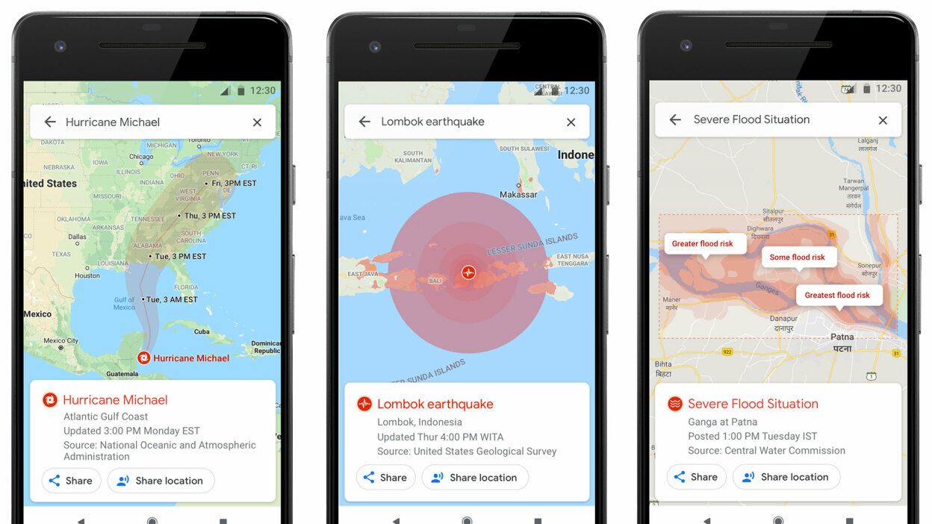
Potential New APIs for WEA
For a mobile OS that already supports advanced emergency alert handling (e.g., Google SOS alert as shown below), APIs are available for government agencies to feed real-time comprehensive disaster information (e.g., earthquake affected area, flood situation, hurricane trajectory prediction, etc.) through the internet (i.e., outside of WEA pipeline). However, currently there is no API to feed WEA information into the mobile OS’s advanced emergency alert handling program.

Slide 34
Potential New APIs for WEA
Currently there are no APIs relevant to WEA on either Apple iOS or Google Android because emergency alert handling is tightly integrated into the mobile OS and does not allow any Apps other than System Apps or First party Apps to access the emergency alert information.
Due to the nature of emergency alerts, any new WEA APIs must be secured and, as such, current mobile device implementations are open only to the System Apps or the First party Apps.
APIs would not be needed if the additional capabilities for emergency alert handling are part of the mobile device OS. Additional feature enablement can be done through OS upgrades.
To enable access to Apps beyond System Apps and First party Apps, the development of new APIs will need to address operational, security, privacy, and any other related requirements. Substantial additional consideration should be given to allow Third-party Apps access WEA parameters. Future CSRIC activities should investigate the use of Third-party Apps for WEA.

Slide 35
Proposals for WEA Enhancements
The proposals described in the report are grouped into the following three categories based on the extent of the identified changes to the current WEA design:
1) Leverages Existing WEA Parameters
2) Requires Additional WEA Parameters
3) Requires Modifications to WEA Design or Alternative Alerting Techniques

Slide 36
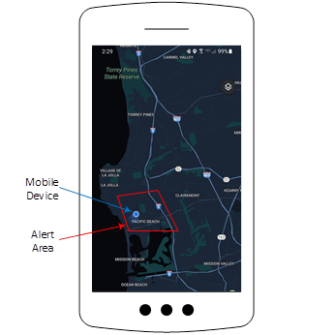
Leverages Existing WEA Parameters
Alert Area Graphic
Maps are commonly used to depict alert location across a variety of alert dissemination methods (e.g., TV, social media). Presenting WEAs in a similar fashion via mapping applications on the device could help the recipient better understand the boundaries of the Alert Area and the device’s location relative to the Alert Area as shown below.

Slide 37
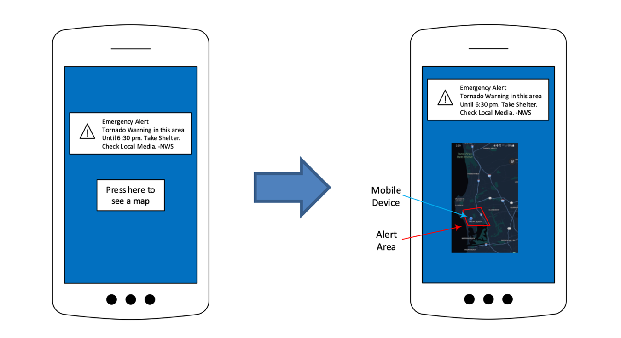
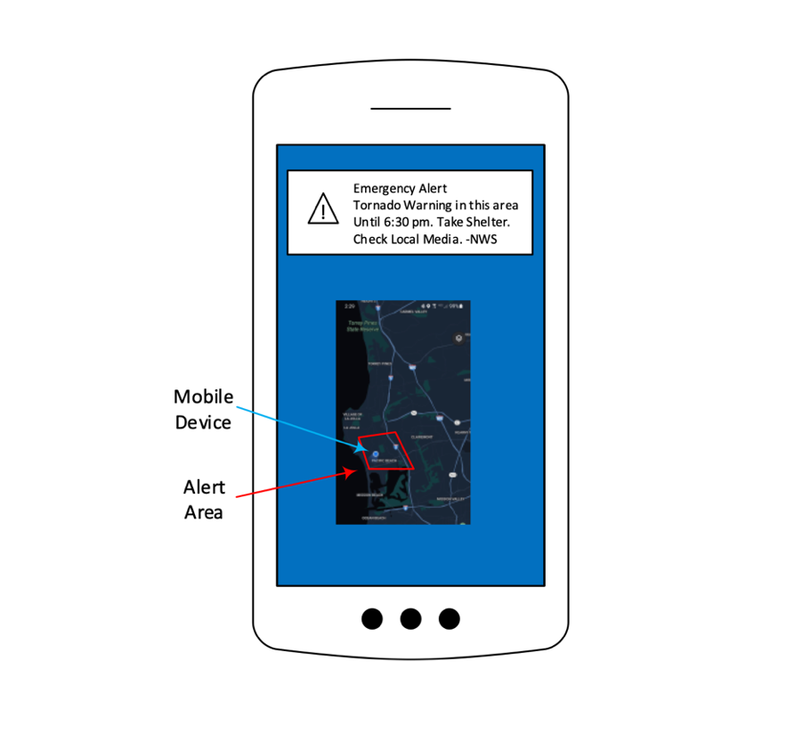
Leverages Existing WEA Parameters
Alert Area Graphic Option 1*: Alert text is immediately displayed and an additional option to display a WEA map is provided.
Alert Area Graphic Option 2: Alert text and a WEA map are both simultaneously displayed.
* CSRIC VIII recommends Alert Area Graphic Option 1

Slide 38
Requires Additional WEA Parameters
Dedicated Audio Attention Signal(s) and Vibration Cadence(s) for Critical Response Time Alerts
The time it takes a person to read the alert may result in losing critical reaction time for some types of alerts (e.g., United States Geological Survey (USGS) Earthquake Early Warning (EEW)). Dedicated audio attention signals and vibration cadences may allow the user to react immediately and read the alert text after taking appropriate action (e.g., DROP, COVER, HOLD ON for USGS EEW).
Establish a dedicated audio attention signal and vibration cadence for specific types of alerts (e.g., USGS EEW). An example of a distinct tone is the one used in the Japanese Earthquake and Tsunami Warning System (ETWS). Update network and mobile device processing as needed to present the new audio attention signal and vibration cadence to the user.

Slide 39
Requires Additional WEA Parameters
WEA Event-Based Notifications
Today, there is a single known and protected audio attention signal and a single vibration cadence associated with all WEA notifications. There have been industry discussions about creating additional audio attention signals/vibration cadences for alert notifications in which user response time is at a premium, but public education to accomplish this may prove challenging. An alternative proposed approach is the use of event-based notifications using a brief, spoken version of the event in the preferred language of the user. A display for specific events with easily recognizable symbols (e.g., tornado) may also allow for quick comprehension.

Slide 40
Requires Modification of WEA Design or Alternative Alerting Techniques
Expand Language Set for WEA
Comprehension is aided when the alert is received in the user’s native language. Currently, alerts can be originated by an AO and broadcast by the CMSP in English and Spanish. Availability of the WEA in additional languages allows more users to quickly comprehend and respond to an alert. Access to additional languages may currently be provided through URLs included in the alert text, though this incurs some delay between the presentation of the alert and access to those translations.
Providing the option of sending WEA alerts in additional languages using the same method currently being used for Spanish would avoid this delay.
Alternative Approaches to Additional Languages for WEA
With improvements in language translation technology, there is an opportunity to provide WEAs in the user-preferred language via language translation of the English alert text at the mobile device.

Slide 41
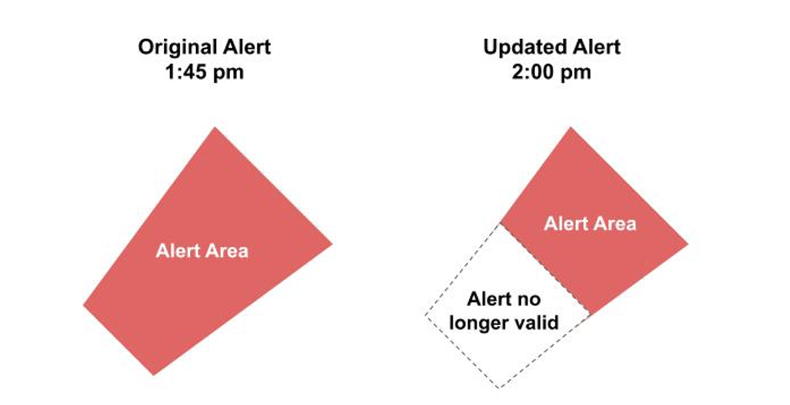
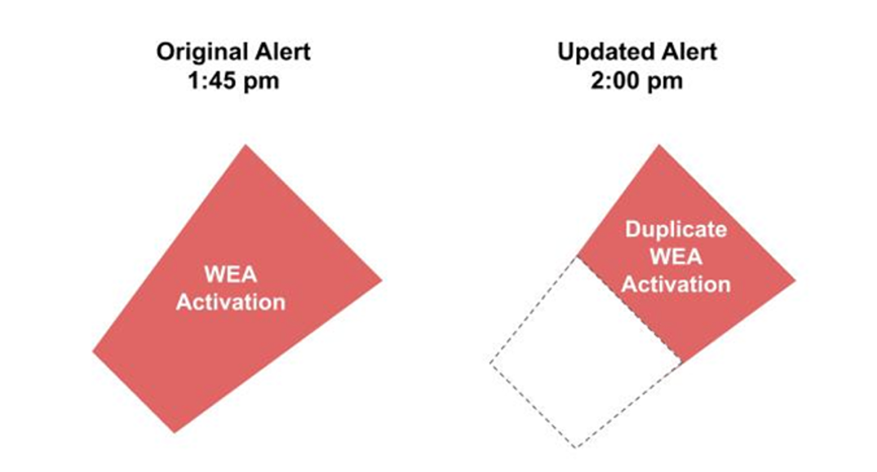
Requires Modification of WEA Design or Alternative Alerting Techniques
WEA Handling of the Threats in Motion
WEA alert updates are processed similarly to new alerts. This poses issues for alerts involving hazards that move, such as weather and hydrologic hazards, which will be exacerbated as alert originator capabilities advance. When an active alert is updated, the broadcast of the original alert is terminated for the entire area defined in the original alert and a new alert (i.e., new unique set of identifiers) is broadcast based on the Alert Area defined for the updated alert, resulting in a presentation similar to the original alert with full audio/visual/sensory cues. This may not always be the most effective approach for users who received the original alert, as these users may perceive the updated alert as a duplicate.
Three categories of use cases, regarding the recipient’s perspective during an update to an alert have been identified:
No new information relative to the recipient—no presentation needed;
Minor new information relative to the recipient—minimized presentation needed; and
Significant new information relative to all recipients—full alert presentation needed.

Slide 42
Official Government URL Shortener
Trust is important in alerting. The ability to have an official government URL shortener with a top-level domain .gov address builds confidence in the alert. Many local government websites use up precious characters in their domain name. Prior to sunset in September 2022, Go.USA.gov was the official URL shortener for federal and State, Local, Tribal and Territorial users. In the sunset page, The Go.Usa.gov Team stated that many social media sites no longer limit characters. Efficient utilization of limited character count is still highly important when issuing alerts, according to AOs.

Slide 43
Recommendations
CSRIC VIII recommends any new WEA APIs must be secured and open only to the System Apps or the First party Apps for the proposals in this report.
CSRIC VIII recommends that ATIS collaborate with all WEA Stakeholders to form recommendations for an order of efforts as parallel development will impact the timelines for each overlapping effort. Prioritization is recommended but has not yet been addressed. ATIS should provide these prioritization recommendations within six months of the acceptance of this report. The recommendations below describe specific enhancements studied by CSRIC VIII. The timelines included for each enhancement represents the estimated time to field with the enhancement considered in isolation.
CSRIC VIII recommends that the Alert Area Graphic Option 1 be incorporated in WEA. ATIS, with input from public warning risk communications experts from the AO community, should develop standards and best practices regarding usability for the various use cases where a map is to be displayed. Usability testing that leverages public warning risk communications expertise should be conducted as part of the standards development process. Once the project is initiated in ATIS, it is estimated that an 18–24 month timeline may be needed for completion of WEA Stakeholder collaboration, usability testing, and standards/best practices development, followed by 18-24 months for mobile device/OS time to field for first device deployments.

Slide 44
Recommendations
CSRIC VIII recommends that WEA be enhanced to speak the name associated with the event in English and/or the user preferred language when the WEA message is presented on the device. Mobile device users should be able to opt-in to this feature if desired. ATIS, with input from public warning risk communications experts from the alert originator community, should develop standards and best practices regarding the use of an event code for this purpose, standardize the spoken name that is associated with each event (or at least for the most popular events) and determine whether unique vibration cadences specific to a very small number of events may be used. In addition, for the USGS EEW, a new audio attention signal specific to this event should be used along with the associated spoken name (e.g., “earthquake alert”) and a unique vibration cadence. ATIS should develop standards required for the signaling of the event code from FEMA IPAWS through the CMSP infrastructure to the mobile device, and handling of the capability in the mobile device. Once the project is initiated in ATIS, it is estimated that an 18–24 month timeline may be needed for completion of WEA Stakeholder collaboration (including members of accessibility community) and standards/best practices development, followed by 18-24 months for FEMA IPAWS, CMSP infrastructure, and mobile device/OS field for first device deployments.

Slide 45
Recommendations
CSRIC VIII recommends that WEA message presentation include a standardized symbol representative of the event. ATIS, with input from public warning risk communications experts from the alert originator community and social scientists, should develop standards and best practices regarding usability for a short list of easily recognized symbols from an internationally recognized symbology table agreed by WEA Stakeholders. This collaborative effort should also consider whether mobile device users should be allowed to opt-in/out of having the addition of this symbol to the presentation of the alert. Once the project is initiated in ATIS, it is estimated that an 18–24 month timeline may be needed for completion of WEA Stakeholder collaboration and standards/best practices development, followed by 18-24 months for FEMA IPAWS, CMSP infrastructure, and mobile device/OS field for first device deployments.
CSRIC VIII recommends that WEA should support languages other than English and Spanish. ATIS, in conjunction with public warning risk communication experts, should conduct a study to determine a feasible, accurate, and effective method for enabling this capability. The study should determine the desired set of languages to be considered for inclusion. The study should determine, for each method proposed, the WEA Stakeholder and capacity impacts and the related limitations (e.g., number of languages, alert text length) that may impact the performance of WEA, as well as the responsible party and placement for the translations of the additional languages. Pros and cons of the proposed solutions should be compared to those of the existing solution that provides an embedded link to a web page that provides expanded languages, as well as against the results of a study performed by appropriate experts on the feasibility of translations by the mobile device. The results of this study should be reported to the Commission with recommendations on further standards development and implementation considerations.

Slide 46
Recommendations
CSRIC VIII recommends that WEA handling of Threats in Motion be improved by modifying the current alert Update procedure. ATIS, AOs, and other WEA Stakeholders should collaborate to study the potential network and user impacts of this proposal as described in Section 5.1.3.3.2 WEA Handling of Threats in Motion. The results of this study should be reported to the Commission with recommendations on further standards development and implementation considerations. If proceeding with this proposal, ATIS should then perform necessary standards and best practices development for WEA Handling of Threats in Motion. Once the project is initiated in ATIS, it is estimated that a 12–18 month timeline may be needed for completion of WEA Stakeholder collaboration and standards/best practices development, followed by 18-24 months for FEMA IPAWS, CMSP infrastructure, and mobile device/OS field for deployments.
CSRIC VIII recommends that if the results of any WEA standardization or collaborative efforts impact existing FCC regulations, then the FCC should determine if the proposed changes are acceptable or additional regulations are needed. This includes changes to 47 CFR Part 10 for a spoken language notification, and/or vibration cadences, and/or audio attention signal and the modification of the audio attention signal when an alert is updated or canceled.

Slide 47
Recommendations
CSRIC VIII recommends that the Commission evaluate the impact to the WARN Act liability protections offered to CMSPs and work with Congress if needed to extend the liability protections to cover the proposals in this report. This includes extending liability protections to CMSPs for any mobile OS and especially to applications outside of the CMSPs’ visibility or control.
CSRIC VIII recommends that an official URL shortener, with a .gov top level domain, is established that can be used by federal departments and agencies as well as State, Local, Tribal and Territorial users for alerting.
CSRIC VIII recommends specific public education activities (See Section 5.1.3 of the report) as part of the realization of each of the above enhancements.

Slide 48
Discussion
Report on WEA Application Programming Interface
WG6: Co-chairs
Farrokh Khatibi, Qualcomm Francisco Sanchez, SBA

Slide 49
Call For Vote
Report on WEA Application Programming Interface
WG6: Co-chairs
Farrokh Khatibi, Qualcomm Francisco Sanchez, SBA

Slide 50
Presentation
WG1: 5G Signaling Protocols Security
WG1: Co-chairs
Brian Daly, AT&T
Travis Russell, Oracle

Slide 51
Working Group 1: 5G Signaling Protocols Security
March 21, 2023
Co-chairs:
Brian Daly, AT&T
Travis Russell, Oracle Communications
FCC Liaison: Ahmed Lahjouji

Slide 52
Working Group 1: Background
The Chairwoman of the FCC directs CSRIC VIII to examine and address security vulnerabilities associated with the newly adopted 5G signaling protocol, Hypertext Transfer Protocol Version 2 (HTTP/2), which, like the SS7 and Diameter signaling protocols considered in earlier CSRICs, is vulnerable to attacks. Researchers have discovered security issues related to the HTTP/2 protocol which could place millions of websites at risk of attack. CSRIC VIII will confirm these vulnerabilities and identify others, assess their potential for harm, and recommend safeguards to harden 5G networks and protect critical business and consumer data from these and other cyber threats. CSRIC VIII will also provide recommendations on how to remediate the risks associated with HTTP/2 and prevent them from carrying over to HTTP/3, the next release of the protocol.

Slide 53
Working Group 1: Objectives
The FCC has learned of four main vulnerabilities and attack vectors related to HTTP/2:
(1) slow read attacks, which call on a malicious client to read responses very slowly;
(2) HPACK Bombs, which are malicious archive files designed to crash the program or system reading them and often disable antivirus software;
(3) Dependency Cycle attacks, which exploit a new flow mechanism designed to optimize networks to instead create an infinite loop which cannot be escaped; and
(4) Stream Multiplexing Abuse, which uses security flaws in stream multiplexing functionality to crash servers, resulting in a denial of service to legitimate users.
We will research these as well as other vulnerabilities and attack vectors identified by industry through industry SMEs and WG member expertise.

Slide 54
Working Group 1: Members
Co-chairs: Brian Daly,* AT&T
Travis Russell,* Oracle
Colin B. Andrews,* Telecommunications Industry Association
Michael Bergman,* Consumer Technology Association
Matt Carothers, Cox Communications
Martin Goldberg,* National Security Agency
Angel V. Gomez, Verizon Communications
Stephen Hayes,* Ericsson
Jithin Jagannath, ANDRO Computational Solutions
Antwane Johnson,* FEMA
Xiaoyang Lee, CISA
John Marinho, CTIA
Martin McGrath, Nokia
Maureen C. Mclaughlin,* Satellite Industry Association
Danny McPherson,* Verisign, Inc.
Derek Peterson,* Wireless Broadband Alliance
Mitch Rappard, Palo Alto Networks
Mike Recchione, ATIS
Anish Sharma, Mavenir
Christopher Wendt, Somos, Inc.
FCC Liaison: Ahmed Lahjouji
*Also a CSRIC VIII Member

Slide 55
Working Group 1: Alternates*
Adam Barron, Verizon Communications
Martin C. Dolly, AT&T, Inc.
Carroll Gray-Preston, ATIS
J. David Grossman, CTA
Brandon Hinton, Satellite Industry Association
Bradley Jackson, Verizon Communication
Navin Jaffer, CISA
Yong Kim, Verisign, Inc.
Mark Lucero, FEMA
John Mattson, Ericsson
Tom McGarry, Telecommunications Industry Association
* Alternates are not a member of the Working Group and may not vote.

Slide 56
Working Group 1: Deliverables/Schedule
WG virtual meetings (generally biweekly) continue
Research/examine security vulnerabilities and attack vectors
Report on Best Practices to Mitigate Vulnerabilities in HTTP/2, June 2023

Slide 57
Status of Work
Working Group is still well ahead of schedule and will have no trouble meeting the deadline for the second report.
As reported in December, Working Group elected to take a different approach and add to the first report with sections on mitigation and recommendations rather than create a brand-new report with cut and paste from the first report

Slide 58
Discussion
WG1: 5G Signaling Protocols Security
WG1: Co-chairs
Brian Daly, AT&T,
Travis Russell, Oracle

Slide 59
Presentation
WG3: Leveraging Virtualization Technology to Promote Secure, Reliable 5G Networks
WG3: Co-chairs
Micaela Giuhat, Microsoft
John Roese, Dell

Slide 60
Working Group 3: Leveraging Virtualization Technology to Promote Secure, Reliable 5G Networks
Co-chairs:
Micaela Giuhat, Microsoft
John Roese, Dell
FCC Liaison: Jeff Goldthorp

Slide 61
Milestone
Report on Recommendation on the Role of the FCC in Promoting the Availability of Standards for More Secure, Reliable 5G Environment Through the Use of Virtualization Technology - June 2023

Slide 62
Working Group #3 Objectives
The second report will include recommendations on:
Steps that the FCC should take (if any) to help coordinate formal standards, informal standards, and any collaborative open-interface community efforts to ensure interoperability in the virtualized 5G space
Recommendations on how the FCC can promote 5G collaborations and innovation labs
Recommendations on actions the FCC can take to build confidence in virtualized 5G solutions using open-source cloud computing software
Any other ways in which FCC can promote a diverse, competitive 5G environment

Slide 63
Working Group 3: Deliverables/Schedule
Completed
Scope and Methodology Agreement January 2023
Create paper outline/sections/leads January 2023
Create list of SMEs and other industry bodies to be invited February 2023
In-person DC workshop March 21
Finish gathering of information April
Collate, edit, finalize Mid-May
Submit pre-read Early June
Report presentation June 26
Completed
Completed

Slide 64
Work Group 3 Expert Presentation Summaries

Slide 65
Presentation 1: 5G Virtualization: A Carrier’s Perspective Presenter: Mike Gallagher, Sr. Manager, Verizon
Highlights:
Walked through of life cycle of a VM or a container; highlight known industry processes, strategies, and challenges; and the purpose to encourage conversation around second report deliverables.
Highlighted stages (obtain, stage, deploy, run, and destroy) involved in life cycle of a virtualized image by design with each stage has its own separation of duties, where the separation of duties offers compromise to the agility.
Assuming a pre-deployed infrastructure in place over either a private or a public cloud and are set up for agility, dev ops, CI/CD models and particularly for the telecommunications model.
Changing of model in the middle of the deployment is disruptive. FCC can guide set of instructions or guidelines on deployment to avoid mid-deployment changes to avoid learning by mistakes.
Occasions to put endpoint security tools within the deployed image in order to monitor it from within. This can be a code within the microservice or an image in the OS.
At each stage, highly recommended to lockdown the repository, scan of deployed images on daily occurrence to avoid any compromises.
Linux Limitations:
Divided up into two areas: user space and kernel space.
System call allows to go from the user space to the kernel space.
Challenges: Allocate system calls permissions in large groups, vendors not delivering cloud native code, over allocating permissions using Linux OS.

Slide 66
Discussion
WG3: Leveraging Virtualization Technology to Promote Secure, Reliable 5G Networks
WG3: Co-chairs
Micaela Giuhat, Microsoft
John Roese, Dell

Slide 67
Presentation
WG5: Managing Software & Cloud Services Supply Chain Security for Comm. Infrastructure
WG5: Co-Chairs
Todd Gibson, T-Mobile
Padma Sudarsan, VMware

Slide 68
Working Group 5: Managing Software & Cloud Services Supply Chain Security for Communications Infrastructure
March 21, 2023
Co-Chairs: Todd Gibson, T-Mobile & Padma Sudarsan, VMWare
FCC Liaison: Zenji Nakazawa

Slide 69
Working Group 5: Background
The Chairwoman of the FCC directs CSRIC VIII to review risks to service provider operations from attacks in service providers’ software and cloud services stacks and develop mitigation strategies for these vulnerabilities. In order to improve supply chain security in the communications industry, the FCC has barred the use of Universal Service Fund support to pay for equipment and services produced or provided by any company posing a national security threat to the integrity of communications networks or the communications supply chain, and the FCC will be reimbursing providers to remove, replace, and dispose of insecure equipment and services. Additionally, prior CSRIC work, such as the CSRIC IV Report on Cybersecurity Risk Management and Best Practices (March 2015), and the CSRIC II Report on Cybersecurity Best Practices (March 2011), focused on attacks that mostly affect traffic on the network or attacks on users through the network.
However, recent breaches of trusted vendors of software have exposed risks in other segments of the supply chain that have resulted in previously trusted systems becoming compromised. Specifically, attackers have inserted malware in to signed code with valid, but compromised, digital certificates. These recent breaches have highlighted that the threat is pervasive and extends well beyond the telecommunications network itself to software components and cloud-based services that service providers rely on to manage and operate their networks. Attacks on these operational networks could have a significant impact on emergency 911 calls and national security communications.
The FCC further directs CSRIC VIII to recommend best practices to mitigate the risks for each vulnerability it identifies, considering the matrix of capabilities of large and small service providers, large and small software vendors, and large and small cloud service providers.

Slide 70
Working Group 5: Members
Co-Chairs: Todd Gibson, T-Mobile & Padma Sudarsan,* VMware
Rob Alderfer,* Charter Communications
Tom Anderson, ATIS
Colin Andrews, Telecommunications Industry Association
Jan H.L. (John-Luc) Bakker, BlackBerry Corporation
Donna Bethea-Murphy,* Inmarsat
Shirley Bloomfield,* NTCA-The Rural Broadband Association
Matt Carothers, Cox Communications
Josh Cech, S&T Telephone Cooperative Association
Ben Goldsmith,* Department of Justice
Dana Golub,* Public Broadcasting Service
Anu Jagannath, ANDRO Computational Solutions
Mohammad Khaled, Ericsson
Jason Lish,* Lumen Technologies, Inc.
Timothy May,* NTIA
Martin McGrath, Nokia
Maureen C. Mclaughlin,* Satellite Industry Association
Travis Reutter,* ACA Connects- America's Communications Association
Nasrin Rezai,* Verizon Communications
John Roznovsky, Mavenir
Sean Scott,* SecuLore Solutions
Jim Stringer, AT&T, Inc.
Richard “Dick” Tenney, CISA
Claire Vishik,* Intel
Kelly Williams, NAB
Henry Young,* BSA | The Software Alliance
FCC Liaison: Zenji Nakazawa
*Also a CSRIC VIII Member

Slide 71
Working Group 5: Alternates*
Reza Arefi, Intel
Tom Breen, SecuLore Solutions
Mark Carmel, CISA
Cathleen M. Dwyer, Verizon Communications
Brandon Hinton, Satellite Industry Association
Brian Hurley, ACA Connects
Mike Parsel, T-Mobile
Tamber Ray, NTCA - The Rural Broadband Association
Mark Roy, Public Broadcasting Service
John A. Schiel, Lumen Technologies, Inc.
Mike Regan, Telecommunications Industry Association
Jason VonBargen, Charter Communications
Timothy Youngblood,** T-Mobile
* Alternates are not a member of the Working Group and may not vote.
** Also, a CSRIC VIII Member

Slide 72
Working Group 5: Milestones/Schedule
Completed Milestone:
Best Practices to Improve Communications Supply Chain Security, September 2022
Next Milestone:
Best Practices to Improve Supply Chain Security of Infrastructure and Network Management Systems, June 2023
Focus will be on Hardware Supply Chain and Implicit Trust of NMS Software Supply Chain
Meeting Schedule:
Currently once a week until the report is finished

Slide 73
Working Group 5: Progress
Completed SME Presentations
Tom Anderson, ATIS –Infra. and Network Management Supply Chain Security
Chris Oatway, Verizon – Co-Chair for the DHS ICT SCRM Task Group
Carlos Manzanares, Nokia – Network Control and Management
Masoud Asadi, Ericsson – Hardware Platform Security
David M. Zendzian, VMware – Supply Chain Levels for Software Artifacts (SLSA)
Peter Colombo, CISA - CISA Cybersecurity Performance Goals
Infrastructure and Network Management Systems Definitions
WG aligned our definitions with the FCC Chairwoman’s office

Slide 74
Working Group 5: Progress
Recent Relevant Cyber Events Identified
Popular IoT software development kits leave critical infrastructure wide open.
Russia attack on satellite Internet network that disrupted Ukrainian infrastructure.
Prevalent Threat Vectors
Memory Unsafe Languages
Continued Operation of End-of-Life Infrastructure
Consumer Grade Infrastructure
WG is continuing to identify and evaluate other events and threat vectors for Report #2.
The Small Provider aspects/inputs have been completed and inserted into draft report.

Slide 75
Working Group 5: Next Steps
Continue to host weekly meetings until report is finished.
WG will continue to make progress on the report and tracking completion by mid-May.

Slide 76
Discussion
WG5: Managing Software & Cloud Services Supply Chain Security for Comm. Infrastructure
WG5: Co-Chairs
Todd Gibson, T-Mobile
Padma Sudarsan, VMware

Slide 77
Closing Remarks
CSRIC VIII Co-chair
Billy Bob Brown, CISA

Slide 78
Adjourn Meeting Suzon Cameron, DFO

Slide 79
NEXT CSRIC VIII MEETING June 26, 2023 at 1:00 pm EDT

