Slide 1
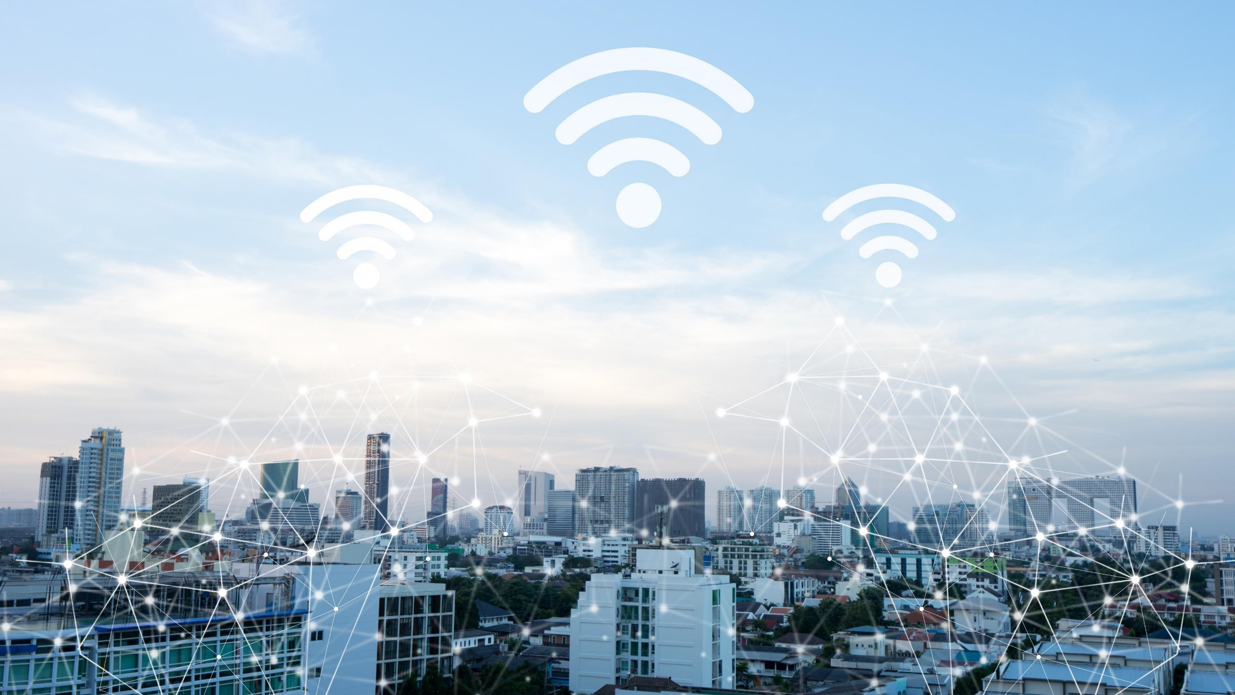

FCC Showcase
Dan Picker CTO

Slide 2

Nasdaq: INSG
Inc. 1996
U.S.-based tech leader in intelligent 4G/5G device-to-cloud solutions
Target customers
  Mobile Network Operators, Enterprise, Private Networks, IoT
  Distance Learning, Work from Home
  Underserved Communities, Government and First Responders
Patent innovations shaping mobile technologies
Core member of 5G ecosystem
  Active member of O-RAN Community
  Enabling tier one global operators to achieve 5G firsts
  Enabling new use cases for the enterprise
5G
Fixed Wireless and Mobile IIoT device-to-cloud
solutions
Cloud-based
enterprise SaaS solutions
All critical IP designed & developed in the USA

Slide 3












Inseego: Putting 5G to Work
5G Customers & Partners*
Inseego’s 3GPP compliant 5G NR portfolio is
kick-starting service provider deployments
and enabling a new wave of use cases that will benefit the global economy.
- Head of Networks Portfolio, ERICSSON
20+
FIRST
GLOBAL
5G commercial launches in
N. America, EMEA & Asia-Pac
5G trials with 5G global mobile network operators & service providers
To enable LIVE 5G NR
Use Cases: enterprise, government, consumer
*PARTIAL LIST

Slide 4

Inseego Cybersecurity
Holistic Approach
Segment Needs
Inseego Secure Security Service
  Carriers: Anti-Hacking
  Advanced encryption
  Anti-Spoofing
  Consumers: Secure Home Network
  Parental Controls
  Education: Enable CIPA Compliance
  Healthcare: Enable HIPPA Compliance
  Enterprise & IP/Transport-Level Security
  Government: Device Administration
  Device Lockdown
  Real-time threat detection
  Remote device management
3rd Party Testing
Multiple layers of security
5G Core
Security

Slide 5





Trusted for Highly Secure Applications

Slide 6
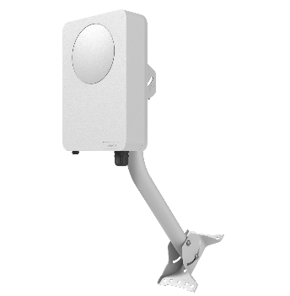
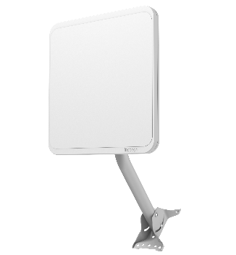
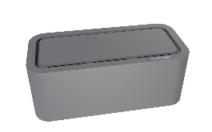
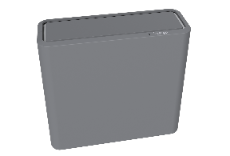
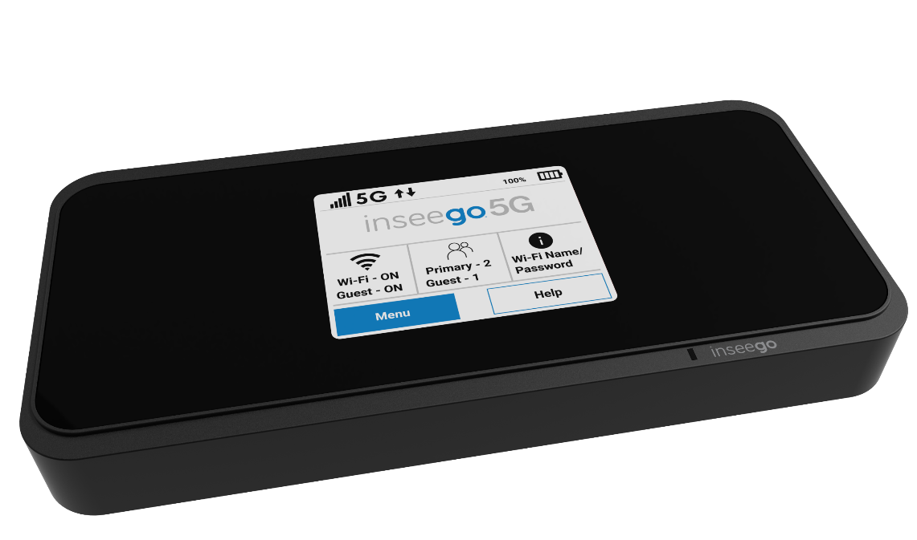
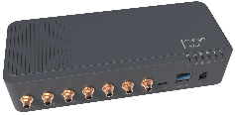
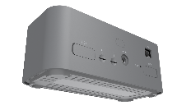
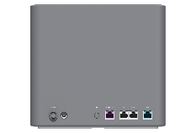
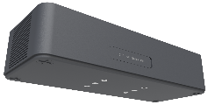
Network and Carrier 5G Product Line 2021
ORAN-Compliant 5G Solutions
MiFi2000
FX2000
FG2000e
FW2010e
FW2000e
S2000e
5G Hotspot
5G Indoor Router
5G Indoor Router
5G Outdoor Modem
5G Outdoor Modem
5G Industrial Gateway
Up to 30 Wi-Fi connections
Education, small business
Dual-SIM (multi-carrier)
Up to 30 Wi-Fi connections
Small offices, retail, dwellings
Dual-SIM (multi-carrier)
Up to 128 Wi-Fi connections
Larger businesses/dwellings
High-power mmW + Sub 6
Urban & Suburban
High gain antennas
Reach up to 6Km with mmW
Buildings/dwellings
Ultra-long-range Sub-6
Suburban and Rural
>10km
Buildings/dwellings
Underserved communities
mmW and Sub-6
Diverse, rugged environs
Ultra-reliable connectivity
Ethernet & USB.
5G mmWave
Yes (mmWave SKU)
Yes (mmWave SKU)
Yes
No
Yes
5G Sub 6
Yes
Yes
Yes
Yes
Yes
Wi-Fi
Up to 30 connections
Up to 128 connections
No
No
No
PoE
No
No
Yes
Yes
Yes
Ethernet
1Gbps capable
5/1/1Gbps capable
5Gbps capable
5Gbps capable
5Gbps capable
PRO value-added features
Carrier unlocked, multi-carrier firmware, dual SIM, FOTA opt-out, ongoing rollout of enterprise security and device management features
N/A

Slide 7



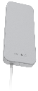

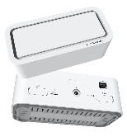


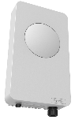
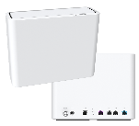
5G Product Line Extending the Network
Fixed Wireless Range
18km
Rural
5.5km
Suburban
2.5km
Urban
FX2000 + Ext. Antenna
Antenna Gain: 9dBi
(sub-6)
FX2000
Antenna Gain: 4dBi
(sub-6)
FW2000 ODU
Antenna Gain: 14dBi (sub-6)
FW2010 ODU
Antenna Gain: 20-22dBi
(mmw)
FG2000
Antenna Gain: 7dBi
(sub-6)
FG2000 w/External Antenna
Antenna Gain: 9dBi
(sub-6)

Slide 8








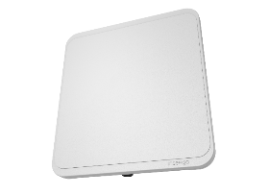






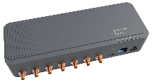

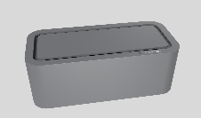

Inseego is a critical player
Inseego builds cellular products that extend infrastructure to more common technology interfaces such as Wi-Fi, Ethernet, and USB.
Inseego’s breadth of portfolio allows us to support many operator and private network use cases.
Base Station
Small Cell
DAS
FWA
EPC/5GC
Network
Application
Services
Private Mobile Core
Edge cloud
(Multi-Access Edge Compute)

Slide 9


We bring out the best of the network
Design
High-Performance RF Engine
Chip Onboard Platform Design
We Set The Design Footprint
Fixed Wireless
Access
(FWA)
Performance
5G Sustained Throughput
  >> OUTPERFORMS Competition by 15-20%
Reliability: <0.6% Field Failure Rate
Trusted by Tier One Operators to Bring 5G to Market
Cloud
Solutions
Mobile
Broadband
Security
3rd Party Tested
Advanced Security Designed in at Product’s Core
Trusted by Government & Financial Institutions
Core Member of 5G Ecosystem

Slide 10

THANK YOU

