Slide 1

Working Group 3:
Managing Security Risk in Emerging 5G Implementations
Working Group Status Update
March 17, 2020
WG3 Chair, Dr. Farrokh Khatibi, Qualcomm Technologies, Inc.

Slide 2
Working Group 3: Background
Working Group Description:
3GPP Release 16, a set of standards which address core elements of the 5G architecture, will be finalized in the March 2020 timeframe. The potential risks introduced into core 5G network elements by weaknesses in the relevant 3GPP standards must be understood so that appropriate mitigation can be undertaken.

Slide 3
Working Group 3: Objectives
The FCC directs CSRIC VII to evaluate the 3GPP Releases 15 and 16 standards, identify areas of risk, and develop risk mitigation strategies to minimize risk in core 5G network elements and architectures.

Slide 4
Working Group 3: Objectives (Cont.)
In addition, the FCC directs CSRIC VII to identify optional features in proposed or work-in-progress 5G standards that can diminish their effectiveness.

Slide 5
WG3 Deliverables: Report 1
Managing Security Risk in Emerging 5G Implementations
The Working Group will review Reports from CSRIC VI WG3 “Network Reliability and Security Risk Reduction” as well as the relevant 3GPP specifications to develop a new repot on “Risks Introduced by Releases 15 and 16 5G Standards”

Slide 6
WG3 Deliverables: Report 2
Managing Security Risk in Emerging 5G Implementations
Furthermore, WG3 will make recommendations to mitigate risks introduced by Releases 15 and 16 Standards. This report will also include identifying optional features in proposed 3GPP standards that can diminish the effectiveness of 5G security, and recommendations to address these gaps.

Slide 7
Working Group 3: Members
Chair: Farrokh Khatibi * Qualcomm Technologies, Inc.
Billy Bob Brown, Jr CISA DHS
Brian K. Daly * AT&T Services Inc.
Christopher(Chris) Joul T-Mobile
Mohammad Khaled Nokia Bell Labs
Michael Liljenstam Ericsson
John Marinho CTIA
Danny McPherson * Verisign
Susan M. Miller * ATIS
Travis Russell * Oracle Communications
Greg Schumacher Sprint
D.J. Shyy MITRE
Lee Thibaudeau * Nsight
Brian Trosper * Verizon
Steve Watkins * Cox Communications
Jeffrey Wirtzfeld CenturyLink
Fei Yang Comtech
FCC Liaison: Steven Carpenter
*Also CSRIC Member
7

Slide 8
Working Group 3: Alternates*
Steve Barclay Alliance for Telecom Industry Solutions (ATIS)
Vinod Choyi Verizon
Martin Dolly AT&T Services Inc.
Yong Kim Verisign
Kathleen Whitbeck Nsight
* These alternates are not a member of the Working Group and may not vote.

Slide 9
Working Group 3: Status
Working Group Membership: Finalized
Working Group Meetings
  Bi-weekly conference calls, with additional calls as needed
Document Library Established (ATIS)
  Contributions / Reference Documents / Calendars
Notes:
Also Post Administrative Documents (Membership, Minutes, etc)

Slide 10
Working Group 3: Deliverables/Schedule
Report 1
Report on Risks Introduced by Releases 15 and 16 5G Standards – September 2020
Report 2
Recommendations to Mitigate Risks Introduced by Releases 15 and 16 Standards. This report will also include identifying optional features in proposed 3GPP standards that can diminish the effectiveness of
5G security, and recommendations to
address these gaps – March 2021

Slide 11
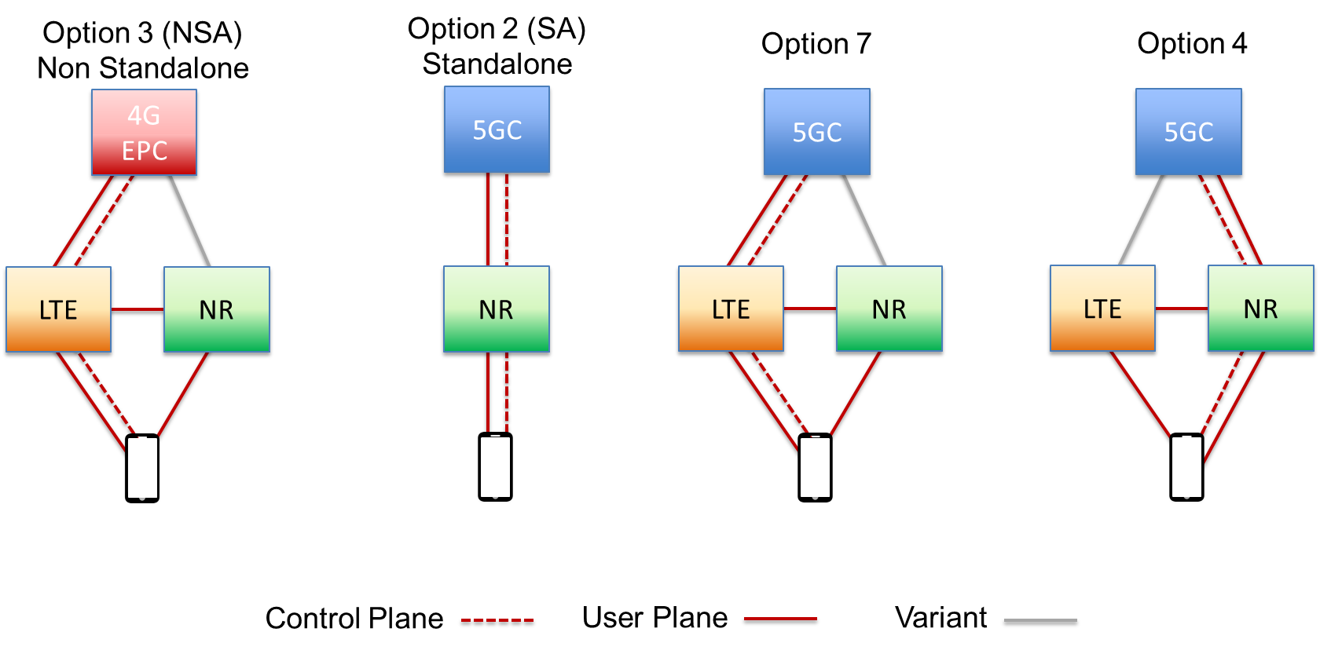
Working Group 3: Scope
The primary focus of WG3 will be on Option 2 (SA) and related options with
5G Core network (5GC)

Slide 12
Working Group 3: Status
Reviewed a number of security related documents/presentations from both research entities as well as standard organizations
Baseline document for the first report is progressing well
Started discussion on new security features of 3GPP Release 16 and analysis of potential security threats

Slide 13
Working Group 3: Next Steps
Continue on our work plan
Continue our analysis of the new Release 16 security features and identify any potential gaps and threats
Continue our baseline report development
Conduct routine bi-weekly conference calls
  Review existing work in the area
  Develop new Recommendations
Provide periodic status updates to Steering Committee and Council

Slide 14
Working Group 3:
Managing Security Risk in Emerging 5G Implementations
Questions?

