Slide 1

REPORT ON THE CURRENT STATE OF INTEROPERABILITY IN THE NATION’S 911 SYSTEMS
Working Group 4: 911 Security Vulnerabilities During the IP Transition
March 17, 2020
WG4 Chair, Mary A. Boyd, Intrado Life & Safety

Slide 2
Working Group 4: Background
Working Group Description:
The transition from legacy to IP-based networks, may result in hybrid system settings that commingle legacy and IP network elements. While in this hybrid state, the 911 systems operate at higher risk. For example, security functions (like data encryption) to protect data traversing through the IP-based networks do not function or are unavailable as the data travels through legacy network elements.

Slide 3
Working Group 4: Objectives
The FCC directs CSRIC VII to identify security risks in legacy 911 networks, transitional 911 networks, and NG911 networks and recommend best practices to mitigate risks in these three areas.
In addition, CSRIC VII will place the vulnerabilities on a scale that accounts for both risk level and remediation expense.

Slide 4
Working Group 4: Objectives (Cont.)
Additional Deliverable:
The FCC directs CSRIC VII to survey the current state of interoperability for the nation's 911 systems, including for legacy 911 networks including for legacy 911 networks, transitional 911
networks, and Next Generation 911 (NG911).
Note: For purposes of this Working Group, interoperability describes the capability of a Public Safety Answering Point (PSAP) to process and share 911 requests for emergency assistance and related data with other PSAPs and with emergency response providers, regardless of jurisdiction, equipment, device, software, service provider, or other relevant factors, and without the need for proprietary interfaces.
Notes:
Move to Summary of Objectives

Slide 5
WG 4 Deliverables: Report 1
911 Security Vulnerabilities During the IP Transition
The Working Group surveyed the current state of interoperability for the nation's 911 systems, including for legacy 911 networks, transitional 911
networks, and Next Generation 911 (NG911); and,
  Remained mindful and compliant of federal rules governing “surveying of information”;
  Identified and reviewed existing 911 reports on the current states of interoperability as data sources; and,
  Identified public safety associations and local 911 Program Offices as additional data sources for completion of the deliverables for the report.

Slide 6
WG 4 Deliverables: Report 2
911 Security Vulnerabilities During the IP Transition
The Working Group will review hybrid 911 system architectures that commingle legacy and IP network elements and:
  Will identify and study historical 911 outages caused by security risks to a 911 network;
  Study networks security risks during the transition of 911 networks for hybrid vulnerabilities;
  Identify security functions to protect data traversing through the IP based networks and impacts through legacy network elements;
  Evaluate existing best practices and develop recommendations to minimize security risks to the legacy 911 networks, transitional 911 networks, and NG911 networks; and
  Evaluate barriers to implementation of security recommendations.

Slide 7
WG 4 Deliverables: Report 3
911 Security Vulnerabilities During the IP Transition
In addition to the review of hybrid 911 system architectures that commingle legacy and IP network elements, the Working Group will:
  Identify and place vulnerabilities on a scale that accounts for risk level;
  Study risk levels and develop remediation expense;
  Review Best Practices and make recommendations to reduce vulnerabilities;
  Identify any economic disadvantages or risks;
  Identify any barriers to implementing mitigation measures; and
  Publish a report measuring risk Magnitude and Remediation costs in 911 and NG911 Network.

Slide 8
Working Group 4: Deliverables/Schedule
Report 1 Title:
Current State of Interoperability for the nation's 911 systems, including for legacy 911 networks, transitional 911
networks, and Next Generation 911 (NG911)
  Finalize By: March 2020 – TODAY’S REPORT
Report 2 Title:
Security Risks and Best Practices for Mitigation in 911 in Legacy, Transitional, and NG911 Implementations
  – Finalize By: September 2020
Report 3 Title:
Measuring Risk Magnitude and Remediation Costs in 911 and NG911 Networks – Finalize By: March 2021

Slide 9
Working Group 4: Members
Chair: Mary A. Boyd, Intrado (Alt: Mike DeWeese)
Brandon Abley, NENA*
Daryl Branson, Colorado State 911 Program
Tom Breen, Comtech
Jay English, APCO*
Laurie Flaherty, US DOT, NHTSA*
Jay Gerstner, Charter (Alt: Robert Dianda)
Jim Goerke, Texas 911 Alliance* (Alt: Richard Muscat)
Jeanna Green, Sprint
Stacy Hartman, Century
Mike Hooker, T-Mobile
Andy Leneweaver, Washington 911*
  Tim Lorello, SecuLore*
  Terry Reese, Ericsson
  Jeff Robertson, RapidSOS*
  Charlie Sassor, NASTD
  Andre Savage, Cox
  Dorothy Spears, Dean, NASNA*
  Leslie Sticht, State of MN
  Gregory Stone, DHS
  Mark Titus, AT&T
  Brian Trosper, Verizon* (Alt: Bill Mertka)
  Jeff Wittek, Motorola Solutions
  Jackie Wohlgemuth, ATIS
  FCC Liaison: Rasoul Safavian
  *Also CSRIC Member
9
Notes:
March Meeting: Note changes in Jeff Robertson and Gregory Stone

Slide 10

REPORT ON THE CURRENT STATE OF INTEROPERABILITY IN THE NATION’S 911 SYSTEMS
(Report 1)
SCOPE:
The Working Group will survey the current state of interoperability for the nation's 911 systems, including for legacy 911 networks, transitional 911
networks, and Next Generation 911 (NG911).
Notes:
Also Post Administrative Documents (Membership, Minutes, etc)

Slide 11
Report 1: Report Structure
Includes an Executive Summary
Provides Historical Background
Includes analysis of Interoperability of Legacy, Transitional, and Next Generation 911 networks;
Includes an analysis of Interoperability from various sources;
  Utilizes TFOPA defined Maturity Levels
  Including select results from quantitative analysis
Provides progress toward NG9-1-1 and Ubiquitous Interoperability
Findings
Conclusions
Notes:
Also Post Administrative Documents (Membership, Minutes, etc)

Slide 12
Report 1: Overview
This report provides the observations discerned through review of independent research based upon publications from various industry groups, including:
A National Plan for Migrating to IP-Enabled 9-1-1 Systems released in 2009 by the National E9-1-1 Implementation Coordination Office (now known as the National 911 Program)
The Phase II Supplemental Report: NG9-1-1 Readiness Scorecard, released December 2, 2016 by FCC Task Force on Optimal Public Safety Answering Point Architecture (TFOPA)
The National 911 Progress Report, released November 2019 by the National 911 Program
The 2020 NASNA Interoperability Matrix, released January 2020 by the National Association of State 9-1-1 Administrators (NASNA)
Additional data from several large Public Safety Answering Points (PSAPs) provided by the Association of Public Safety Communications Officials (APCO)

Slide 13
Report 1: Transition Paradigm: Use of TFOPA Maturity States for Interoperability Baseline
Legacy State
The Legacy stage is characterized as the point in time where 9-1-1 services are provided by the traditional incumbent local exchange carrier (ILEC) with circuit-switched infrastructure and Automatic Location Identification (ALI) circuits.
Foundational State
As the name implies, the Foundational stage is where the groundwork and planning for NG91-1 implementation is initiated. NG9-1-1 feasibility studies are performed, Geographic Information System (GIS) data preparation commences, and IP networks may be implemented. NG9-1-1 systems are not yet operational and system procurement is either planned or underway
Transitional State
The Transitional state is the point at which services have migrated partially from the legacy environment and the 9-1-1 services are enabled by an IP infrastructure. The Emergency Services IP Network (ESInet) is in place and ESN routing is still being utilized. This is the first state in which certain Next Generation Core Service elements may be implemented. At this point, a governance model has been established. Systems in this State are said to be NG9-1-1 Transitional.

Slide 14
Report 1: Transition Paradigm: Use of TFOPA* Maturity States for Interoperability baseline (cont.)
Intermediate State
The Intermediate State is the state in which the 9-1-1 Authority has implemented and made operational all i3 Core functions within their control and all calls are routed per GIS boundaries and location information (i3 algorithms). Additionally, an i3 PSAP multimedia call handling system (terminating ESRP) is implemented. Infrastructure and applications are being refined to incorporate advanced call- and data-delivery interfaces. Business and performance elements are maturing and are reviewed in regular intervals to optimize operations. Governance agreements are in place and the model is functioning. Systems in the Intermediate State are said to be NG9-1-1 Ready.
Jurisdictional End State
The Jurisdictional End State is the state in which PSAPs are served by i3 standards-based systems and / or elements, from ingress through multimedia "call" handling. Originating Service Providers are providing SIP interfaces and location information during call set-up time. Within the jurisdiction, ESInets are interconnected providing interoperability which is supported by established agreements, policies and procedures. Systems in the End State are NG9-1-1 Compliant.
National End State
The National End State is the state in which PSAPs are served by i3 standards-based systems and/or elements, from ingress through multimedia "call" handling. Nationally, ESInets are interconnected providing interoperability which is supported by established agreements, policies and procedures. All systems in the End State are NG9-1-1 Compliant.
Notes:
Speak to the Maturity states and data analysis; Explored the Maturity states for progress towards NG911 Interoperability.

Slide 15
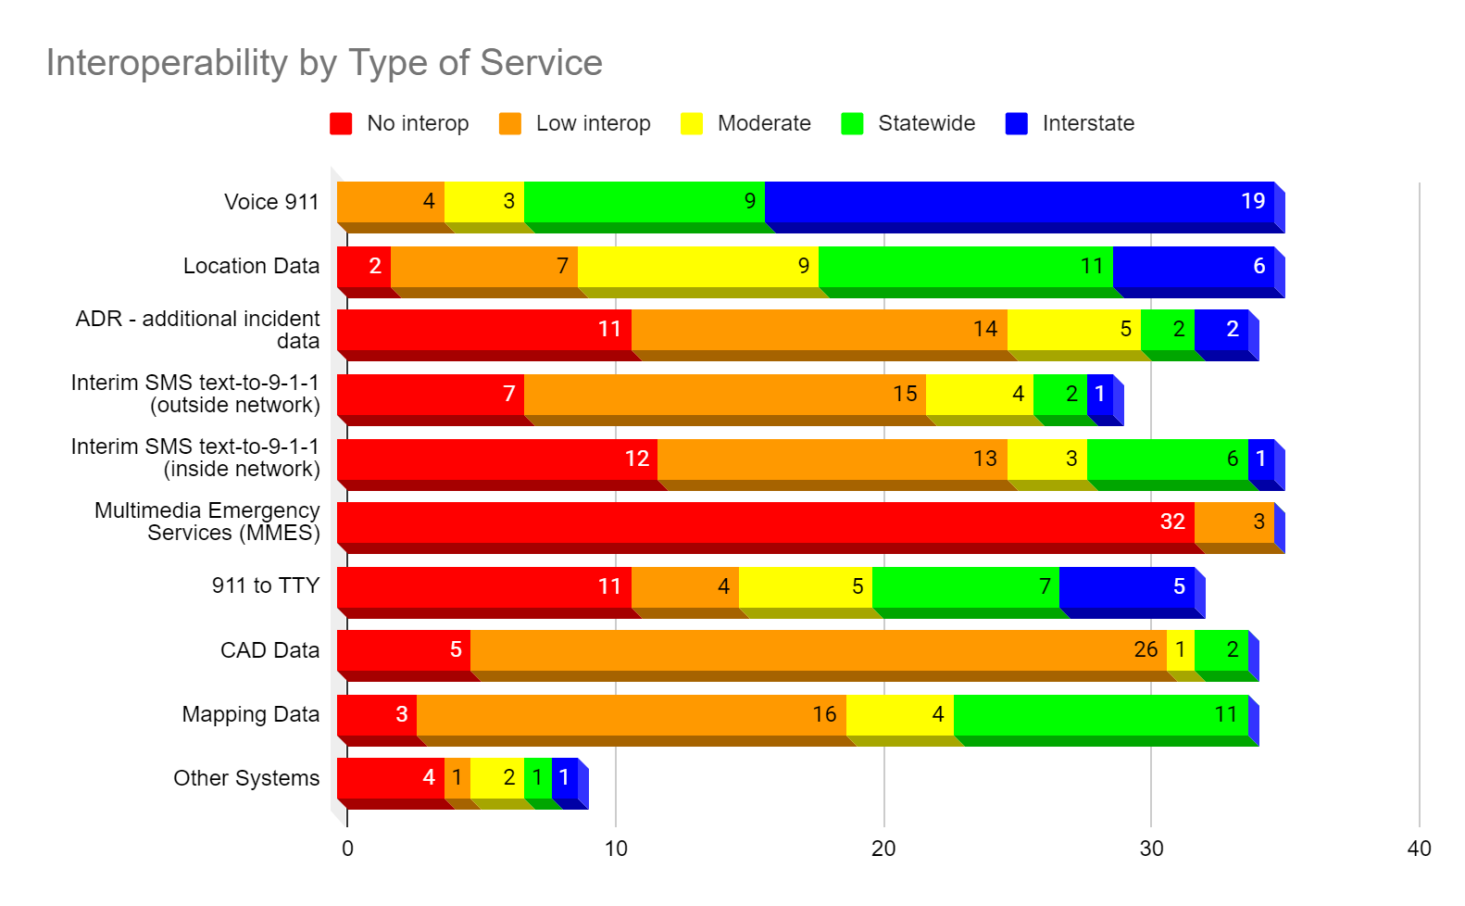
Report 1: Progress Towards Interoperability*
Notes:
Thirty-seven (37) states responded to NASNA’s data request. No territories or tribal entities responded. The states that did respond are distributed relatively evenly across the United States.
Each respondent was asked to rate their state’s level of interoperability in several categories type of communication content:
voice 9-1-1 calls
location data
additional incident data
text-to-9-1-1 (using means other than the 9-1-1 network for delivery)
text-to-9-1-1 (using the 9-1-1 network for delivery)
multimedia emergency services (MMES)
9-1-1 to TTY
computer assisted dispatch (CAD) data
mapping data
other systems
For each of these categories, respondents were requested to rate the category by level of interoperability:
No interoperability - No PSAPs in the state have this level of interoperability with any other PSAPs.
Low interoperability - Some PSAPs have this level of interoperability with some other PSAPs on a limited basis (such as with immediate neighbors).
Moderate interoperability - Most PSAPs have this level of interoperability with most other PSAPs in the state, although there are some non-compliant PSAPs.
Statewide interoperability - Every PSAP in the state has this level of interoperability with every other PSAP.
Interstate interoperability - This state’s PSAPs have this level of interoperability with PSAPs in one or more neighboring states. For states with international borders, each was asked to identify any existing international interoperability.
.

Slide 16
Report 1: Findings
NASNA reported from responding State 911 Program Offices that voice 9-1-1 was the highest level of interoperability among the PSAPs. However, the technologies used to manage the incident after initial receipt and through dispatch of emergency response field personnel had a lower level of interoperability. The more advanced technologies used day to day by the general public such as multi-media services had a very low level of respondents indicating interoperability.
The key findings of the November 2019 National 911 Progress Report indicate that 39% of participants have awarded a statewide NG9-1-1 contract and 31% of PSAPs have implemented an ESInet. This result is a leading indicator in assessing the current state of 9-1-1 interoperability as the establishment of the ESInet IP network
Notes:
Several sources of data for the findings: PSAPs, NANSA, Program Office, APCO

Slide 17
Report 1: Findings (cont.)
It is important to note that while CSRIC VII is primarily focused on identifying cybersecurity threats and mitigation strategies to be employed by public safety during the transition to NG9-1-1, a key baseline to completing this activity is to ascertain the state of current 9-1-1 interoperability. The greater the state of current interoperability, the greater the immediate need for cybersecurity threat identification and mitigation technologies and strategies.
Notes:
Several sources of data for the findings: PSAPs, NANSA, Program Office, APCO

Slide 18
Report 1: Conclusions
The United States needs to continue to move forward with the deployment of NG9-1-1, with a strong focus on achieving interoperability, as defined in the report, which includes industry standards-based solutions.
The quicker these solutions can be implemented and tested, the quicker the country will meet the goals of the Commission and experience the benefits of full-scale interoperability.
This concludes overview of Report 1.

Slide 19
Working Group 4: Next Steps
Report 2 – Kickoff Held March 3rd to define report framework and content; with also a focus on Report 3 deliverables as they are related;
Establishment of Project Plan
  Framework
  Bi-Weekly meetings – Conference Calls
  Timeline
Report Deadline: September, 2020
Document Library: ATIS Workspace (AWS)
  AWS is used as a primary tool for management of the Working Group attendance, duties and updates.

