Slide 1

Working Group 2:
Managing Security Risk in the Transition to 5G
Council Update
December 10, 2019
Lee Thibaudeau, Chair
Nsight

Slide 2
Working Group 2: Background
Working Group Description:
As Fifth Generation (5G) wireless technology is widely deployed by wireless service providers in the United States and around the world, its evolutionary design will incorporate a number of existing standards from previous generations. This approach risks the persistence in 5G of security issues that exist in currently deployed networks. For example, researchers have identified several vulnerabilities in the attach, detach, and paging procedures of earlier generation wireless technology that may negatively affect the confidentiality, integrity, and availability of wireless networks and continued challenges in avoiding fake base stations in 5G networks.

Slide 3
Working Group 2: Objectives
The FCC directs CSRIC VII to review risks to 5G wireless technologies that may carry over from existing vulnerabilities in earlier wireless technologies that can lead to the loss of confidentiality, integrity, and availability of wireless network devices. CSRIC VII will recommend best practices to mitigate the risks for each vulnerability it identifies and address recently proposed solutions by security researchers.

Slide 4
Working Group 2: Objectives (Cont)
Additionally, the FCC directs CSRIC VII to recommend any updates, if appropriate, to the 3GPP SA3 (security working group) standards, including digital certificates and pre-provisioned Certificate Authorities, to mitigate these risks and then place the vulnerabilities on a scale that accounts for both risk level and remediation expense.
Finally, the FCC directs CSRIC VII to identify optional features in 3GPP standards that can diminish the effectiveness of 5G security, and recommendations to address these gaps.

Slide 5
Deliverables/Schedule
Report 1 June 2020
Report on Risks to 5G from Legacy Vulnerabilities and Best Practices for Mitigation
Report 2 December 2020
    Report on Recommended Updates to 3GPP Standards and Comparison Risk and Remediation Expenses for 5G Vulnerabilities (including identification of optional features in 3GPPstandards that can diminish the effectiveness of 5G security and recommendations to address these gaps)

Slide 6
WG2 Deliverables:
Managing Security Risk in the Transition to 5G
The Working Group will focus on the transition from 4G to 5G
  Review lessons learned from previous technological advances
  Gather input from researchers, technologists and standards bodies
  Perform an assessment of implementation best practices
  Identify updates needed to the existing body of knowledge
  Identify barriers to implementation

Slide 7
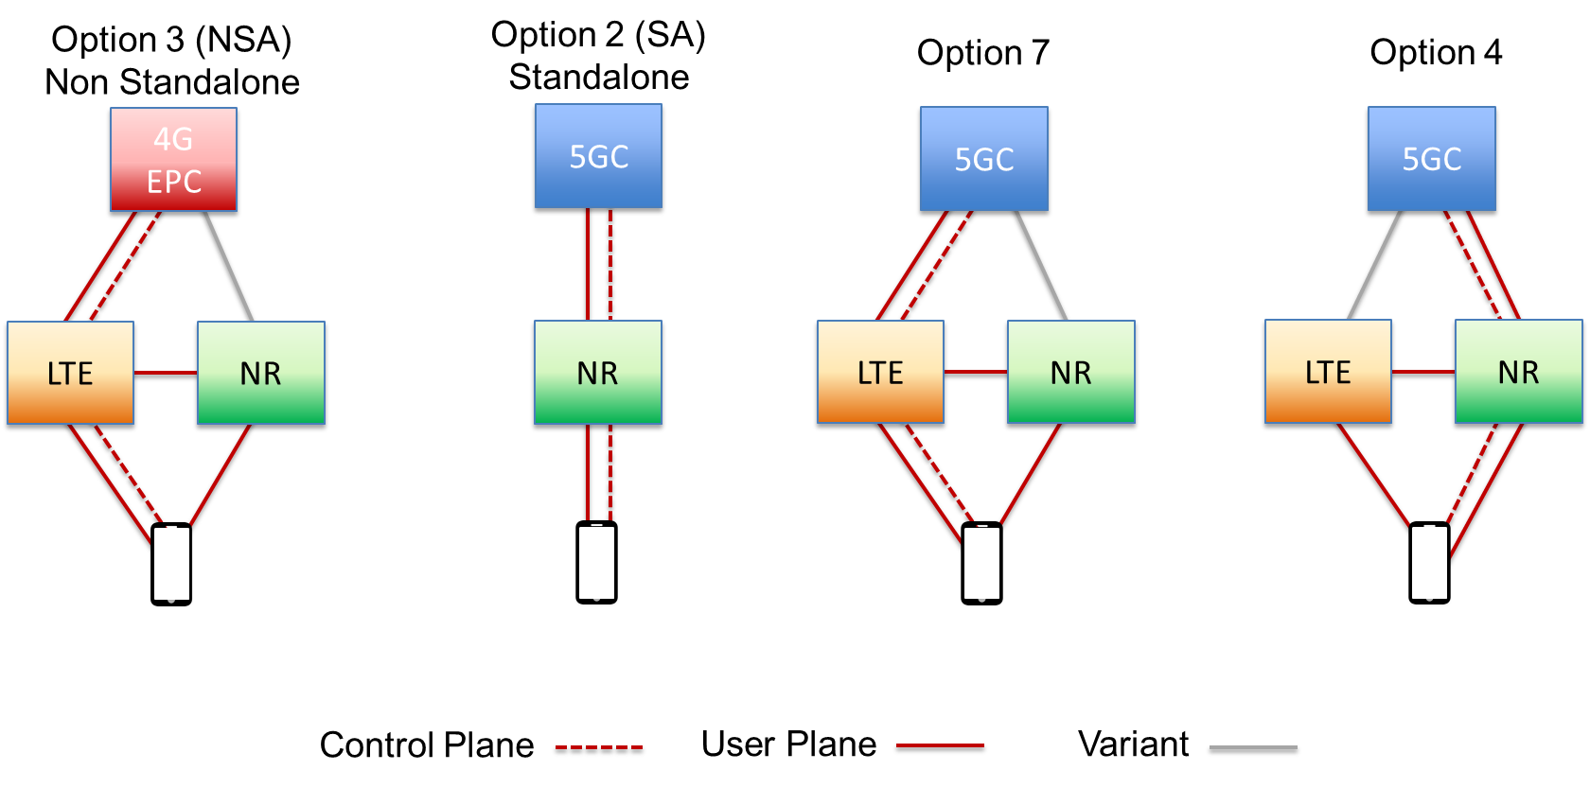
Working Group 2 Focus
Working Group 2 will focus on Option 3 (NSA) as the transition to 5G networking.
7
7

Slide 8
Working Group 2 Members
Name | Company
Lee Thibaudeau * (Chair) | Nsight
Brandon Abley * | NENA
Nicholas E. Arconati | AT&T
Jason Boswell | Ericsson
Paul Diamond | CenturyLink
Charlotte Field * | Charter Communications
Mohammad Khaled | Nokia Bell Labs
Farrokh Khatibi * | Qualcomm
John Marinho | CTIA
Susan M. Miller * | ATIS
Drew Morin | T-Mobile
Travis Russell * | Oracle Communications
Greg Schumacher | Sprint
Sandeep Shrivastava | Orchestra Technology
Brian Trosper * | Verizon
David Villyard | CISA DHS
Fei Yang | Comtech
Mike Geller | Cisco
Kurian Jacob | FCC Liaison
* CSRIC VII Council Member
8

Slide 9
Working Group 2 Members
(Alternates)
Name | Company
Jeff Matisohn | Charter Communications
Yousef Targali | Verizon
Jeff Wirtzfeld | CenturyLink
Steve Barclay | ATIS
Kathy Whitbeck | Nsight
9

Slide 10
Working Group 2 Status
Weekly Discussions In Progress
Report 1 Time Line Defined
Gathering input from academic, industry and government researchers to assess impacts to existing and emerging best practices
Outlined and began drafting of Report 1
WG2 / WG3 Chairperson discussions to coordinate work efforts, reduce overlap or gaps
Joint WG2 / WG3 discussions where appropriate

Slide 11
Next Steps
Continue weekly Working Group discussions
Draft Report 1
Continue to recruit additional subject matter experts, review research against existing and emerging standards and industry practices
Coordinate work efforts with Working Group 3 where appropriate and complementary
Begin development of a work plan and time line for Report 2 (December 2020)
Provide periodic status updates to the CSRIC Council

Slide 12
Working Group 2:
Managing Security Risk in the Transition to 5G
Questions?

