Slide 1

Public Safety answering points
Real-Time Text
Education Day regulatory overview
Karen Peltz Strauss, Deputy Chief
Consumer and Governmental Affairs Bureau
Federal Communications Commission
October 2, 2018

Slide 2
FCC Real-Time Text Proceeding
December 2016: FCC adopted rules to facilitate a transition from TTYs to real-time text (RTT) over wireless Internet Protocol (IP) technologies
New rules permit the support of RTT in lieu of supporting TTY technology
Covered entities: IP-based wireless providers,Manufacturers of end user equipment
  Covered entities that support RTT are relieved of TTY support requirements on their wireless networks and equipment, including services and devices used for legacy non-IP facilities
October 2, 2018
Real Time Text Education Day

Slide 3


Why the transition?
TTYs use outdated technology, are slow (60 wpm), require turn-taking (half duplex mode), allow for only limited characters, use specialized equipment, and are not reliable in an IP environment.

Slide 4

Real-Time Text features
Communications convey automatically, without clicking “send.” Allows first responders to act on incomplete messages.
Provides ability to use voice and text simultaneously on the same call in both directions
Provides ability to initiate and receive calls with regular telephone numbers
Offers more character options – universal alphabet, symbols, emojis
Can use with off-the-shelf equipment
October 2, 2018
Real Time Text Education Day

Slide 5
Real-Time Text FCC Requirements
Interoperability required across networks and devices
  FCC established the RFC 4103 technical standard as a safe harbor for ensuring RTT interoperability
  RFC 4103 has been specified for use by NENA for IP-based next-generation text communications where SIP technology is used (NENA i3 Architectural Standard)
  Simultaneous text and voice must be available in the same call session
FCC rules encourage other voice calling features:
  Alert indicators, same latency and error rates, pre-installed (default) functionality, teleconferencing, and other common calling features
October 2, 2018
Real Time Text Education Day

Slide 6
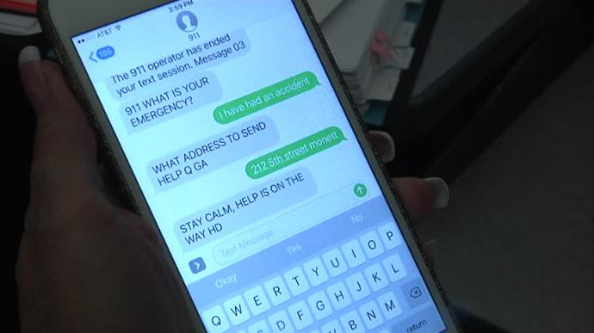
Real-Time Text Requirements
Backward compatibility with TTYs
  To ensure RTT users and TTY users can continue to communicate directly with one another, especially in emergencies
  RTT-to-TTY communications are limited to the character set and turn-taking of TTY equipment
  Public outreach and education is helpful to convey these limitations to potential users
October 2, 2018
Real Time Text Education Day

Slide 7

FCC vs. DOJ jurisdiction over 911 matters
Americans with Disabilities Act: Implemented by the Department of Justice
  State and local governments, including PSAPs, must provide effective communication for people with disabilities
  Requires direct access to emergency services - Accepting calls through relay services will not satisfy the access requirement.
  Allows for “future technological advances” to achieve compliance

Slide 8


FCC vs. DOJ jurisdiction over 911 matters
Department of Justice rules and interpretation:
  PSAPs must “at a minimum” use TTYs or “other equally effective telecommunications systems to communicate with individuals with hearing and speech disabilities.”
  PSAPs must use a TTY or equally effective telecommunications system to communicate with text users, regardless of how the communication originated – e.g., by SMS [or RTT], barring a showing of fundamental alteration or undue burden.
Communications Act: FCC regulates telecommunications and advanced communications service providers and manufacturers, not PSAPs

