Slide 1

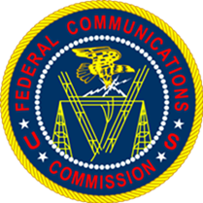
The Essentials in Adopting
Direct Videoconferencing Telecommunications

Slide 2
Direct Video Calling (DVC): Summary
Direct Video Calling (DVC) is video teleconferencing that allows conversations to occur between two callers using American Sign Language (ASL), without the need for translation services.
The Commission encourages entities in the private and public sectors to adopt measures so that such callers can avail themselves of DVC for business and personal calls.

Slide 3

Telecommunication Relay Services (TRS): Traditional Non-DVC Solution
TRS is a telephone service that allows individuals who are deaf, hard of hearing, or speech disabled to place and receive telephone calls.
TRS uses communications assistants (CAs) to facilitate telephone calls for individuals who need TRS assistance.

Slide 4
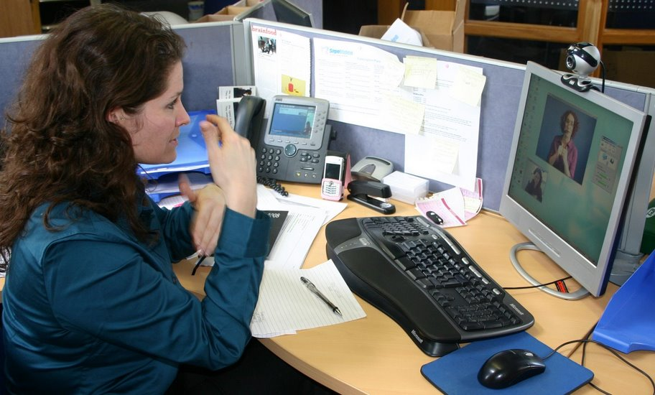
Video Relay Services (VRS):
Traditional Non-DVC Solution
VRS is a form of Telecommunications Relay Service that enables ASL-fluent persons who are deaf and hard of hearing to communicate with voice telephone users through video equipment, rather than through typed text.
Video teleconferencing connects the VRS user with a communications assistant, so that the VRS user and the CA can see and communicate with each other in signed conversation.
Because the conversation between the VRS user and the CA flows much more quickly than with a text-based TRS call, VRS is an enormously popular form of TRS.

Slide 5
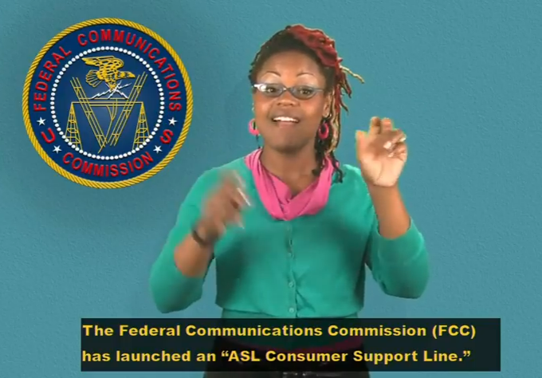
Direct Video Calling (DVC)
In June 2014, the FCC’s Disability Rights Office implemented an ASL Consumer Support Line —the first of its kind in the federal government. Statistics show that:
  The number of calls from ASL-fluent callers increased three-fold,
  Incoming relay calls to FCC’s main toll-free number have nearly been eliminated, and
  Calls are being handled and resolved faster.
DVC solutions have since been adopted by a variety of government agencies and private corporations, and the number continues to grow.

Slide 6






Benefits of DVC
Improved Communications
Simple Implementation
Secure Communications
Cost Savings
Maintain ADA Compliance
Career Opportunities

Slide 7
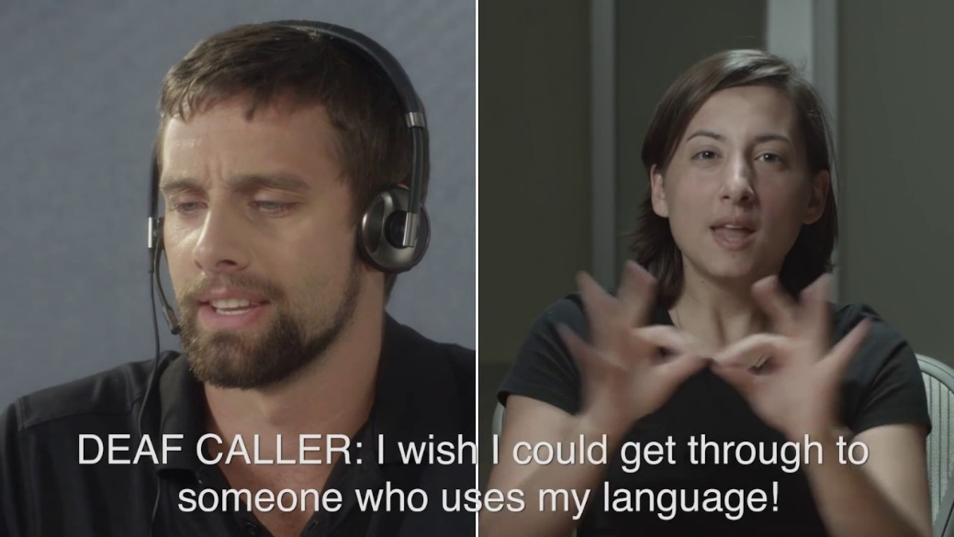
Additional Benefits of Adopting DVC
DVC provides equivalent and direct access to your entity’s services via American Sign Language.
This is especially helpful if:
  Your organization provides programs and services such as:
    Social and health services
    Employment and rehabilitation programs
    Educational institutions and training centers
    Language interpretation and communication services
    Hotlines and 311 information and reporting services
    Any service that may be handled over the telephone

Slide 8

Implementing DVC for Your Entity
There are many DVC platform options available.
Solutions range from:
  simple videophone platforms provided by existing VRS vendors, to…
  complex call-routing systems such as the ACE Direct platform, which was developed by the FCC.
Your ideal option will depend on your enterprise needs.

Slide 9
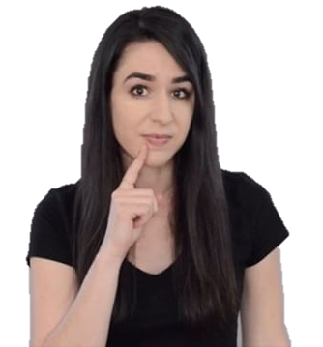
What does an entity need to deploy DVC?
High-speed Internet connection
  Minimum: Dedicated speeds of 1 Mbps download/upload per agent
Video conferencing equipment (e.g., camera and a video screen)
A calling platform compatible with the national relay numbering system
An iTRS-issued phone number
Personnel who are native users of American Sign Language
  This increases the number of individuals with disabilities in the workplace, and heightens your entity’s profile with various disability communities.

Slide 10
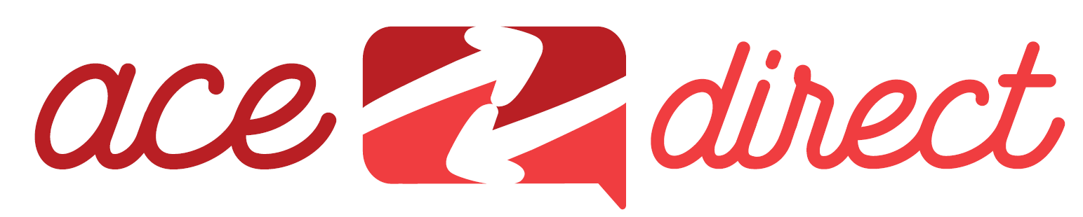
What is ACE Direct?
Off-the-shelf VRS endpoints seem to lack telephony features common in call center platforms, such as call routing and call queueing.
To meet the complex needs of DVC call center deployments, the FCC developed an open-source Direct Video Calling software solution, which is freely available.
  Capable of routing video calls into specific queues for multiple agents
  Integrates easily with an organization's customer relations management (CRM) databases
  Based on free, open source software
  For more information: www.fcc.gov/ace/direct

Slide 11
Contact Information for FCC DVC Team
Robert McConnell,
Telecommunications Accessibility Specialist
  Email: DVC@fcc.gov
  Voice/Video: 202-769-0760
  Web: www.fcc.gov/DVC

